Slide 1
Royal Netherlands Society of Engineers
Engineering Society

Slide 2
Can you imagine a world without engineers?

Slide 3
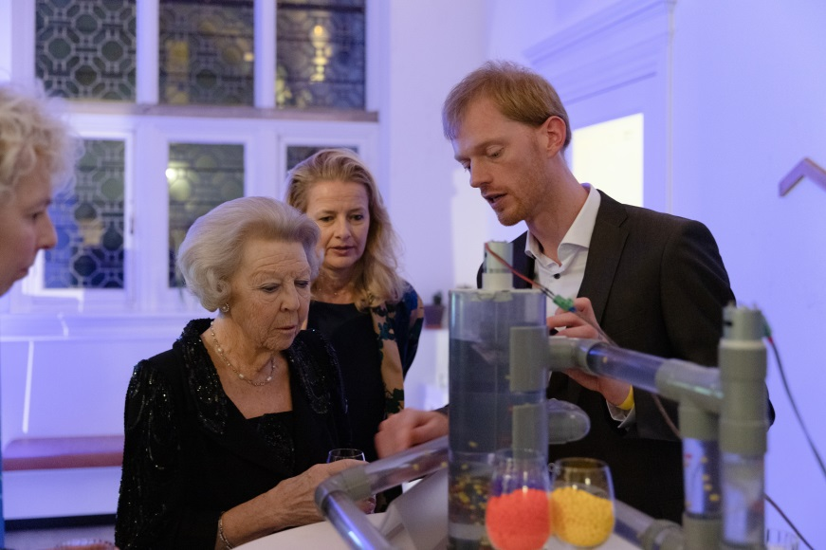
About KIVI
KIVI is the Dutch professional association for engineers. Within KIVI, all engineering disciplines and engineers in all stages of their careers are represented.
Notes:
Opgericht in – Founded in
ruim 17.500 leden – over 17,500 members

Slide 4
Our mission
Supporting engineers in their professional activities
Recognition of engineering activities
Connecting with research, education, society, and each other
Safeguarding the quality of education and research
Deploying the expert knowledge of engineers for societal issues
Projecting the impact of technology on society
Collaborating with industries, knowledge institutions,
Higher education, the government, and foreign partners

Slide 5
Our added value
Facilitating the
professional and personal
development of engineers
Further development and recognition
of engineering activities
Supporting companies
that want to induce growth for
their engineers (and company)

Slide 6
Membership benefits for engineers
De Ingenieur (magazine)
Reliable expert information and news
Member services
Communities in the work field
Participation in social projects relating to technology
Expanding your network
Personal development
Professional registration
Participating in activities

Slide 7
Reliable information and news from your area of expertise
More than 50 departments
38
12
2
10
Disciplines
Regions
Students & Young Professionals
Circles
The separate regions ensure that members throughout the country have access to KIVI resources
Discussion groups focusing on technological or social topics and issues
Engineering disciplines keep members updated on the developments in their specific fields
Multidisciplinary sections that focus on students and engineers below the age of 35
https://www.kivi.nl/afdelingen/vakafdelingen
https://www.kivi.nl/afdelingen/regionale-afdelingen
https://www.kivi.nl/afdelingen/extra-afdelingen
https://www.kivi.nl/afdelingen/kringen

Slide 8
De Ingenieur
Tech magazine and #1 online platform for engineers
Daily news items, weekly newsletters and monthly online magazine
Vacancies: higher vocational/academic level

Slide 9
KIVI member services
Discounts on over 50 professional magazines
Discount on legal assistance
More than 100 engineer coaches
KIVI Academy (in partnership with Cisco)
100
55
Engineer coaches
Magazines
Experienced engineers and mentors who offer advice and assistance to other members during every phase of their careers.
Discounts on over 55 magazines and publications such as Frame, Bits&Chips and Ocean Energy & Resources.

Slide 10
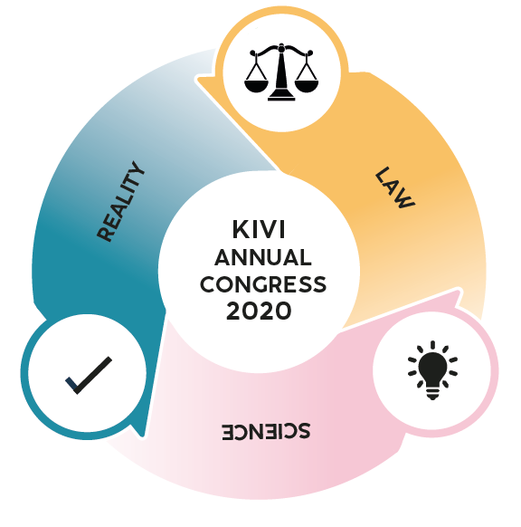
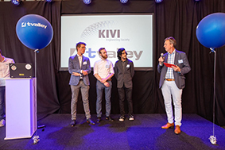
Activities
400
Activities
per year
Connecting with engineers, the industry, the academic world, and the government
Continuous
professional
development
Notes:
Image:
KIVI ANNUAL CONGRESS 2020
LAW SCIENCE REALITY

Slide 11
Activities
Lectures
Online and offline networking sessions
Webinars
Round table meetings
Events
Prince Friso Engineering award
KIVI Annual Congress
Excursions

Slide 12
Social projects relating to technology
Future Society Project:
Plastic Packaging Materials
Future Society Project:
Future Society Project:
KIVI Climate Report
Circular Education Deal
Help with the COVID-19 crisis

Slide 13
Expand your network and share your knowledge!
Get in touch with other professionals in your field, engineers of all disciplines, Young Professionals & Captains of Industry, Higher Education, Research Institutes, the business world, etc.
Through your discipline(s) and communities
Through training programmes
Through events
Through get-togethers and excursions
Through project groups focusing on social issues
Through activities in (higher) education
Through coaching

Slide 14
Professional and personal development
Free access to coaches and sparring partners who can help to advance your career.
Professional registration (EU ing, Chartered Engineering)
Competency-oriented development
In this age of fast technological developments, innovations, and transformations, it is crucial to maintain professional agility. There is a growing need for a broader, competency-oriented development. We developed a competencies framework that offers the tools to realise this.
KIVI Academy (with online courses)

Slide 15
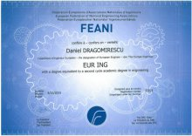
Professional registrations
KIVI offers two professional titles:
KIVI members have access to the incorporated and chartered pathway for professional and competency development.
Get an internationally accredited qualification that requires mandatory continuous professional development
Chartered Engineer (CEng)
Incorporated Engineer (IEng)
The title of Chartered Engineer can be obtained at academic/master’s degree level
The title of Incorporated Engineer can be obtained at undergraduate/bachelor level

Slide 16
International competencies framework
Competency
Competency
Competency
Competency
Competency
A
B
C
D
E
Knowledge of and insight into engineering
Designing, developing, and creating innovative products, systems, processes, or services
Leadership, responsibility, and management
Stakeholders, communication and interpersonal skills, team work
Professional commitment

Slide 17
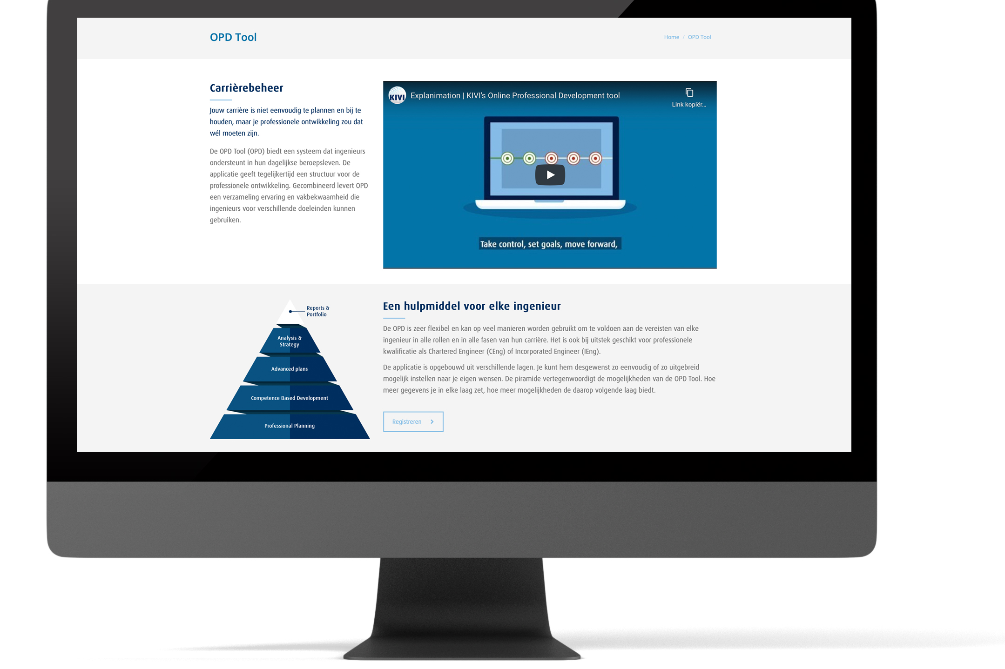
Online Professional Development Tool
Participants can start using this OPD straight away!
The portfolio forms the foundation for the chartership pathway
During the process, KIVI supports the candidates and provides mentors when desired

Slide 18
Online Professional Development Tool

Slide 19
Join KIVI
KIVI wants you to find the scope to develop your profession and career by offering a broad package of facilities that will make it a lot easier to keep yourself updated on professional information and news. Besides that, you can rely on KIVI when you need personal coaching and career counseling and support, and we create opportunities where you can contribute to social/political issues relating to technology.
Join KIVI
Join KIVI at www.kivi.nl or send an email to info@kivi.nl

