Slide 1
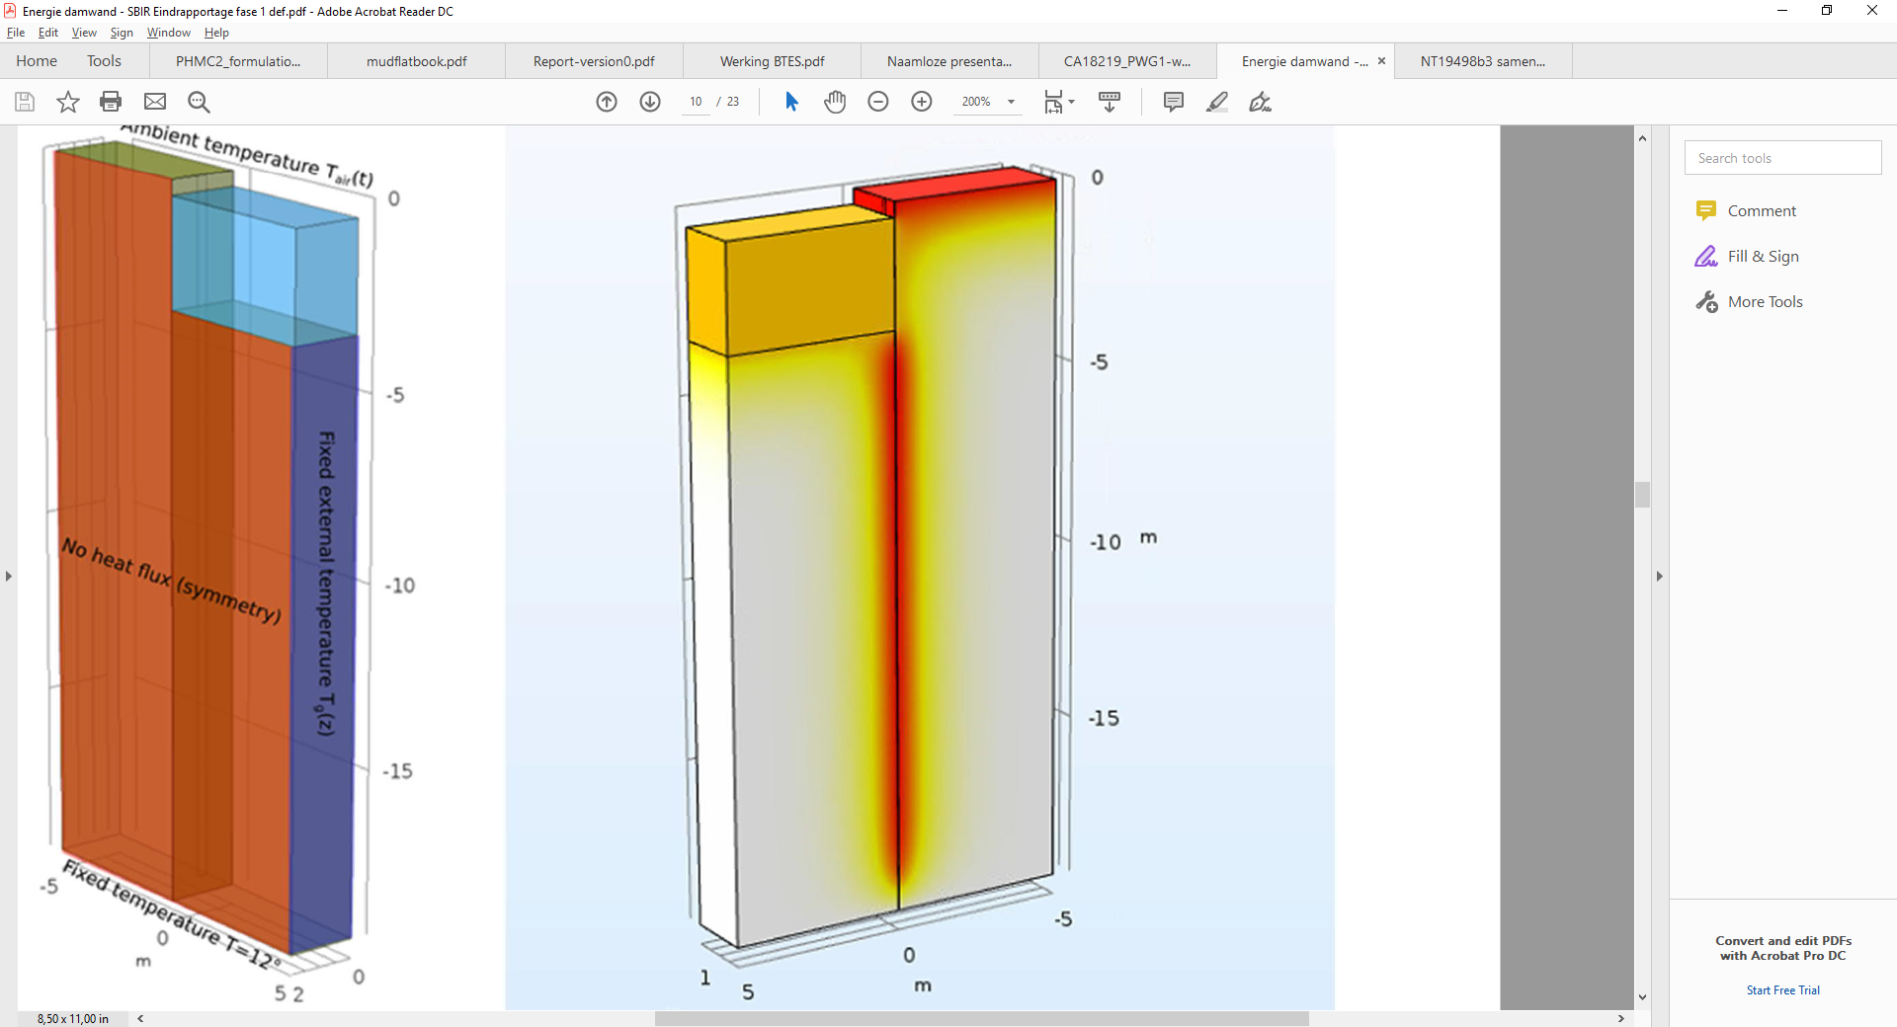
Energy everywhere
The implications of using geotechnical infrastructure as energy infrastructure
Phil Vardon
Professor Energy Geo-mechanics
Notes:
Some details – mainly big picture…..details you can ask

Slide 2
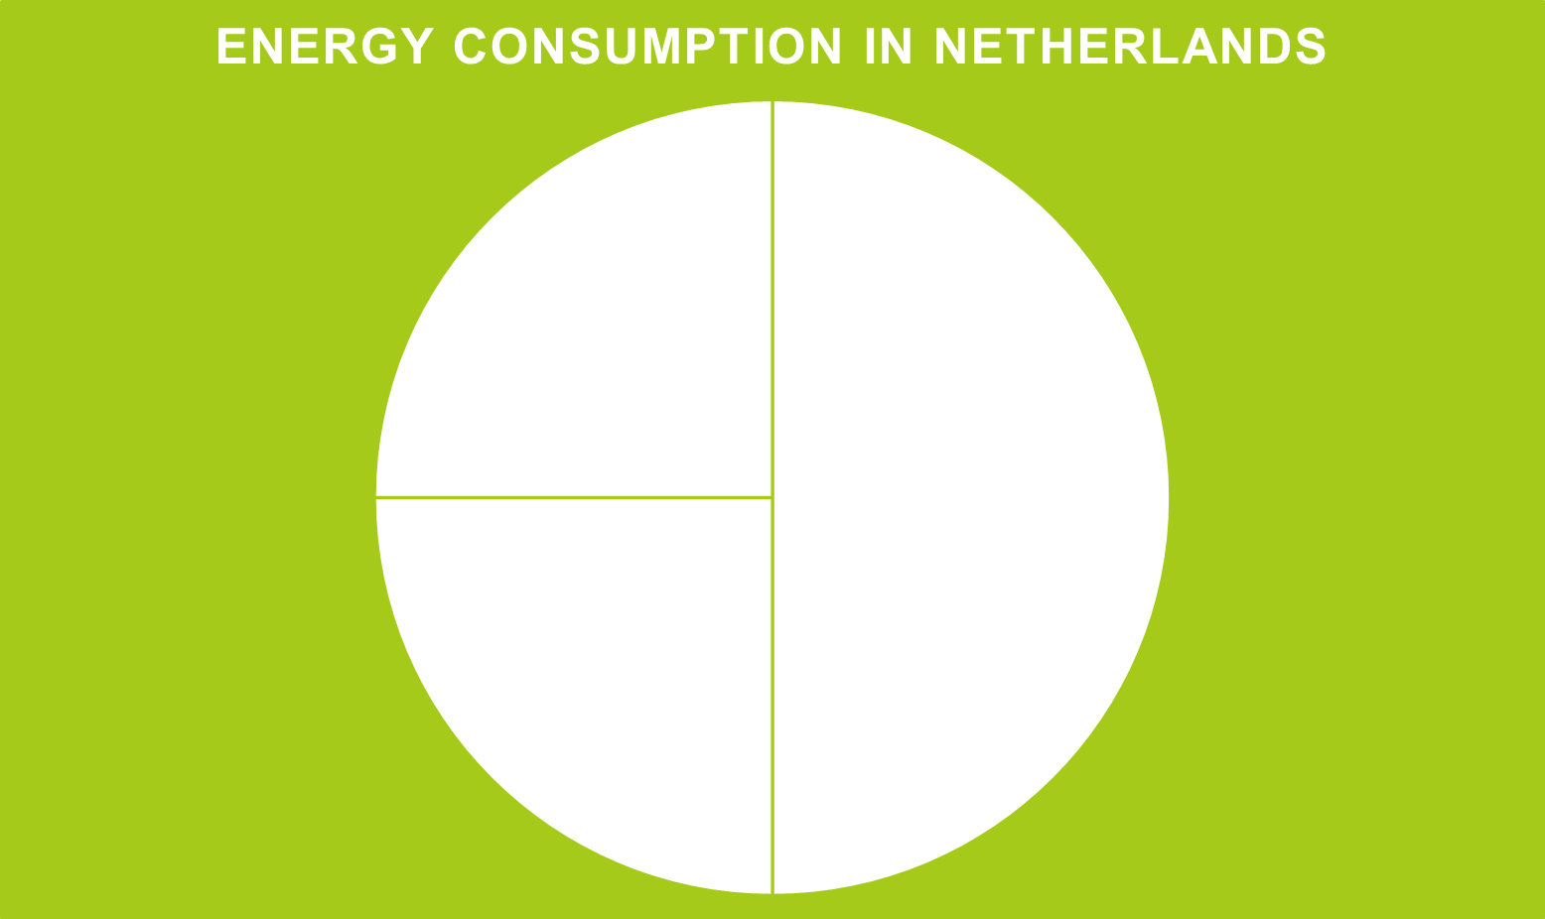
Heat and the energy transition

Slide 3
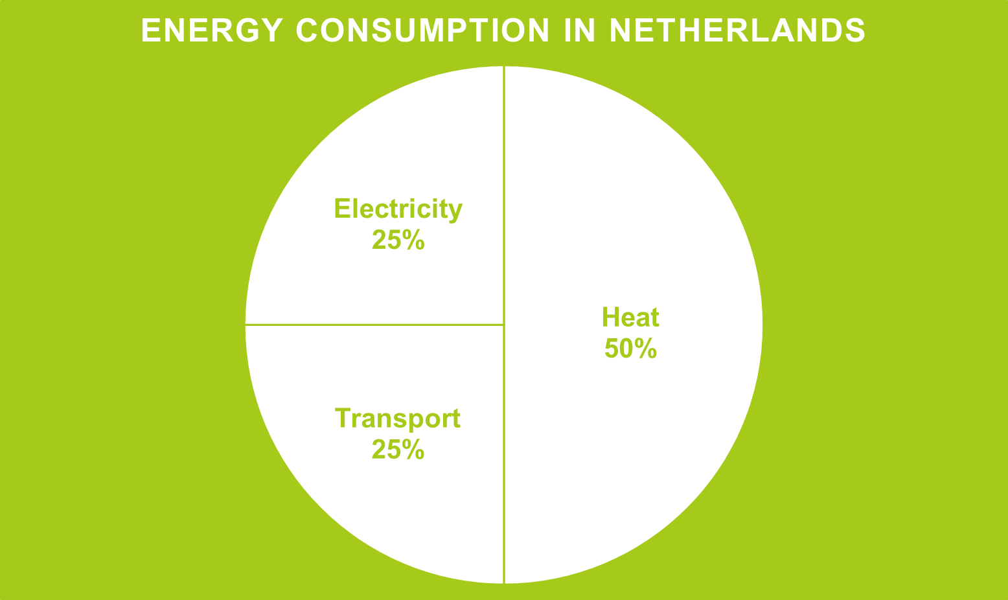
Heat and the energy transition

Slide 4
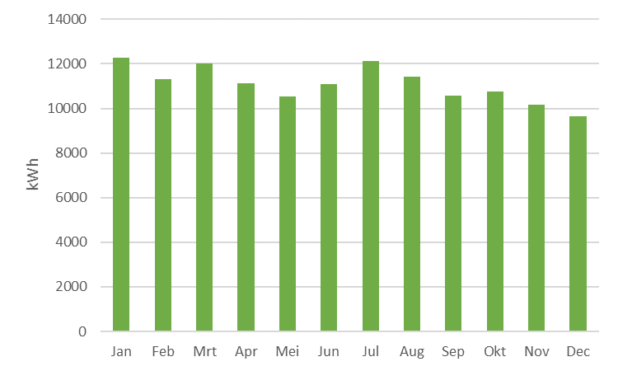
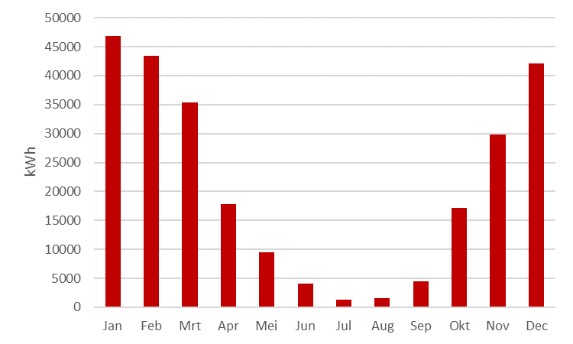
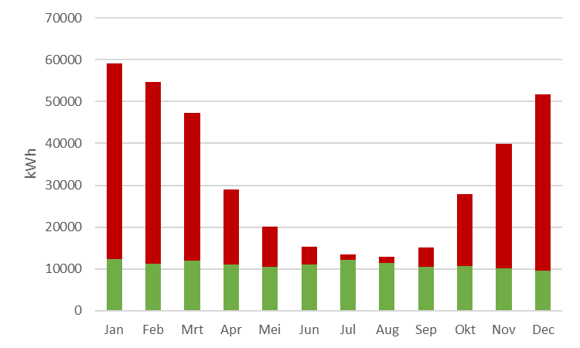
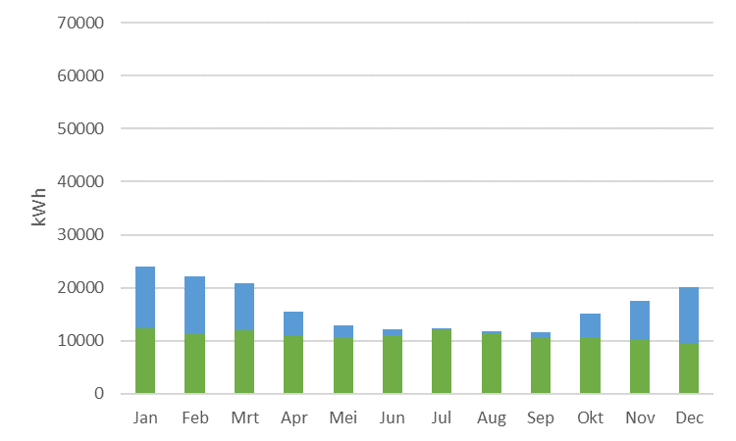
Energy usage – typical NL
Electricity usage
Gas usage
Electricity and gas usage
Electricity (incl. for heatpump) usage

Slide 5
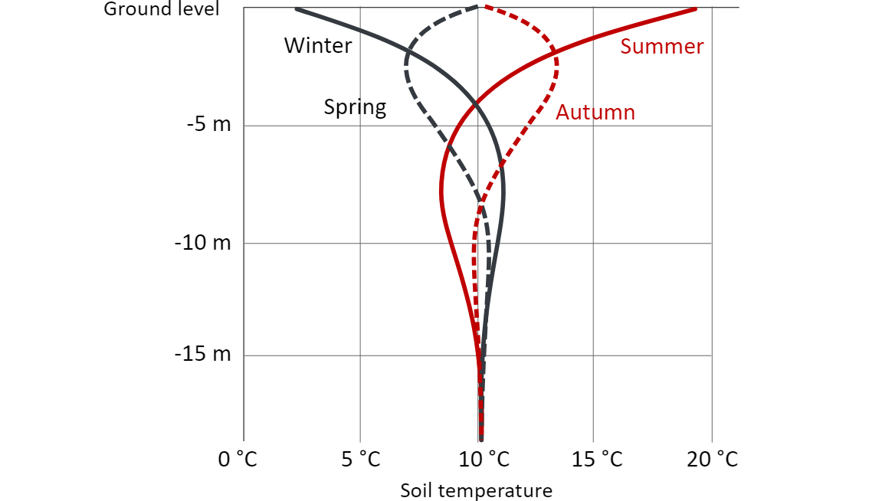
There is no energy problem.
There is an exergy problem.
Notes:
Figure on thermal profile of the ground.
Energy is available – but not at high temperature. Rennovate buildings.
We need it warm when it is cold, we need it cold when it is warm.

Slide 6
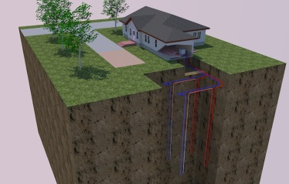
Shallow geothermal – heat and/or cooling
Notes:
Keeping things in the right place, getting things out

Slide 7
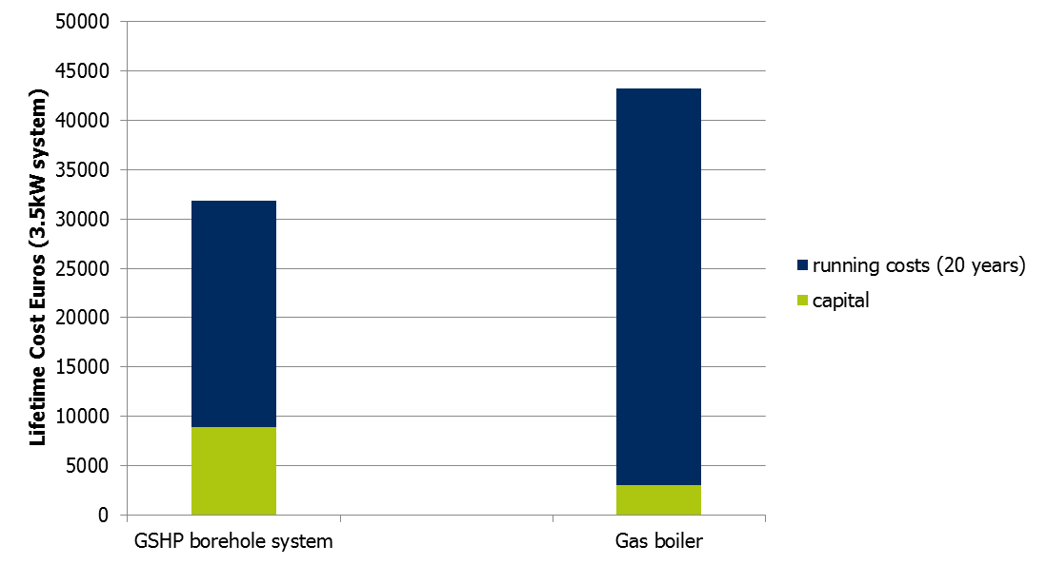
Why is shallow geothermal not already used everywhere?
COP = 3.5 (assumed, conservative for good system)
4% increase per year for electricity and gas (electricity ~ 2x gas price)

Slide 8
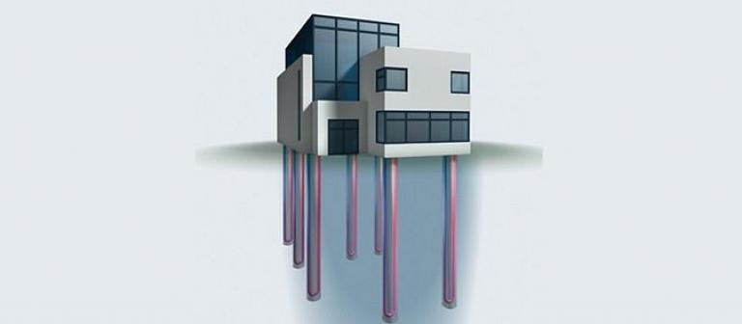
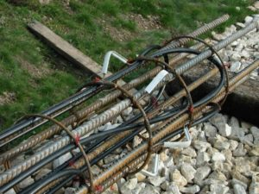
Energy geostructure (pile)
Notes:
This applies to all energy infrastructure

Slide 9
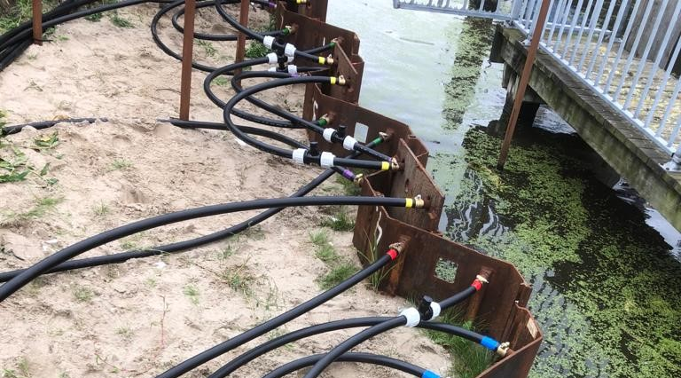
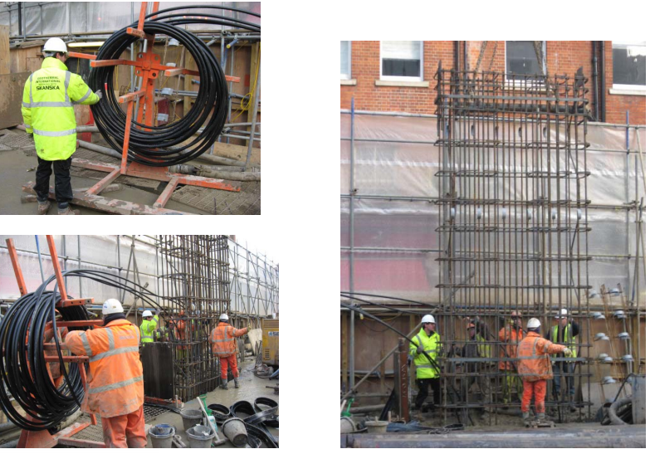
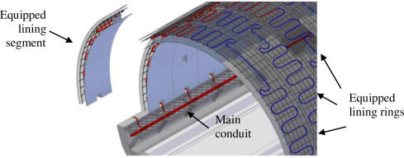
Energy geo-structures
Vardon, 2020
Geothermal International, 2011
Barla et al., 2016
Notes:
Energy tunnels / walls etc….

Slide 10
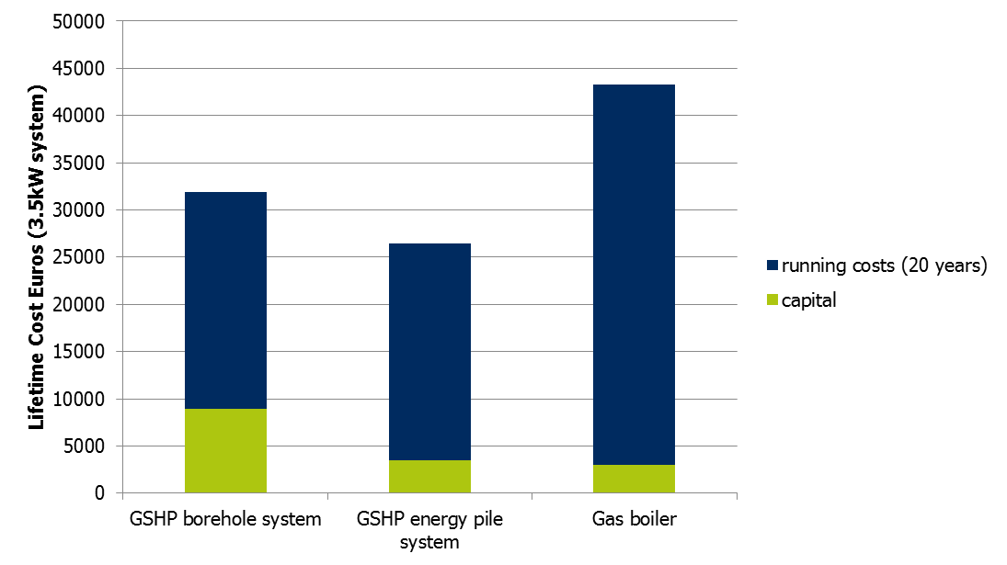
Why is shallow geothermal not already used everywhere?
COP = 3.5 (assumed, conservative for good system)
4% increase per year for electricity and gas (electricity ~ 2x gas price)

Slide 11
Design
Energy:
  Material properties: methods exist
  Heat is stored, spacing is important
  New well-insulated buildings means energy geo-structures are very possible
  Much work is available: not discussed today
Impact on structures
  Design structure, then energy system
  Structure dependent
  Slow cyclic loads (days and years)

Slide 12









Thermal expansion and stress changes
$$∆σ$$
$$∆σ=D∆ε$$
Normal geotechnics
$$∆σ$$
$$∆σ$$
Thermal geotechnics
$$∆ε=∆ε_{T}+∆ε_{m}$$
$$∆T$$
$$∆σ$$
$$∆σ=D (∆ε−∆ε_{T})$$
$$ε_{T}=[I]∆T.α$$

Slide 13









Thermal expansion and stress changes
$$∆σ=D (∆ε−{∆ε}_{T})$$
$$ε_{T}=−[I]∆T.α$$
Extreme 1: fully constrained
$$∆ε={∆ε}_{m}{+∆ε}_{T}=0$$
$$∆T$$
$$∆σ=−D∆ε_{T}$$
$${∆ε}_{m}{=−∆ε}_{T}$$
Extreme 2: fully free
$$∆T$$
$$∆σ=0$$
$$∆ε−{∆ε}_{T}=0$$
$$∆ε=−[I]∆T.α$$
Most situations are between these two.
Notes:
Apply strain, then check mechanics….

Slide 14

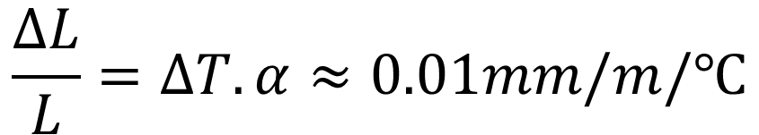

Thermal expansion - structure
Extreme: time = 0
$$∆T$$
$$ε_{T}$$
$$∆γ$$
$$\frac{∆L}{L}=∆T.α≈0.01mm/m/℃$$
Notes:
Shear strains on soil from structure….

Slide 15
Thermal strength and stress changes
CNL
CNS

Slide 16


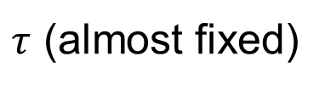
Thermal creep
Extreme: many thermal cycles
$$∆T$$
$$∆T$$
$τ$ (almost fixed)
Notes:
No change in mechanical loading

Slide 17
Material thermo-mechanics
Materials do not change strength (much) with temperature (in this range)
Confining stresses can reduce with cyclic shear strain cycles – need large cycles
Thermal creep exists

Slide 18
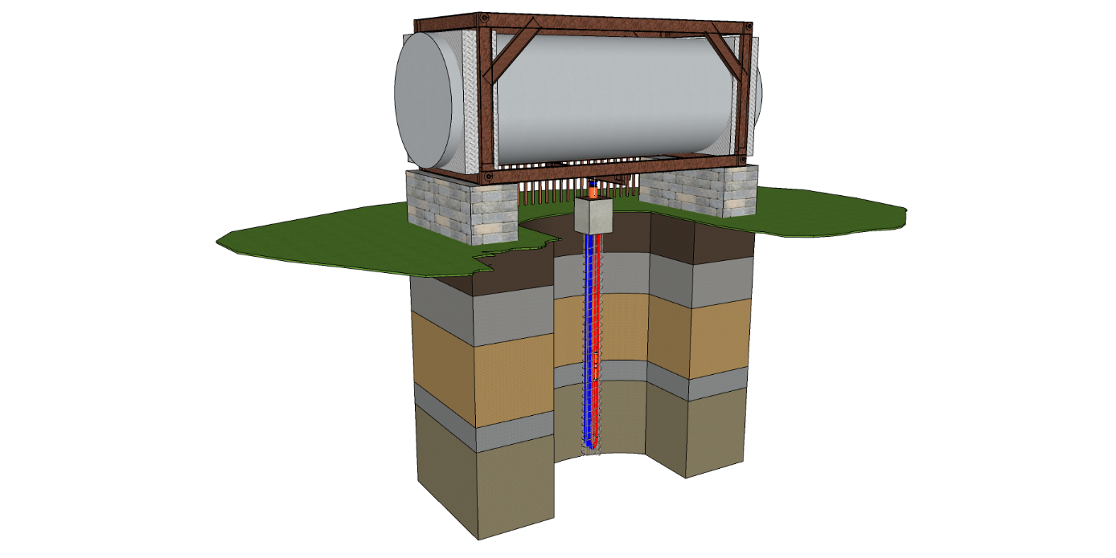
Thermal pile test

Slide 19
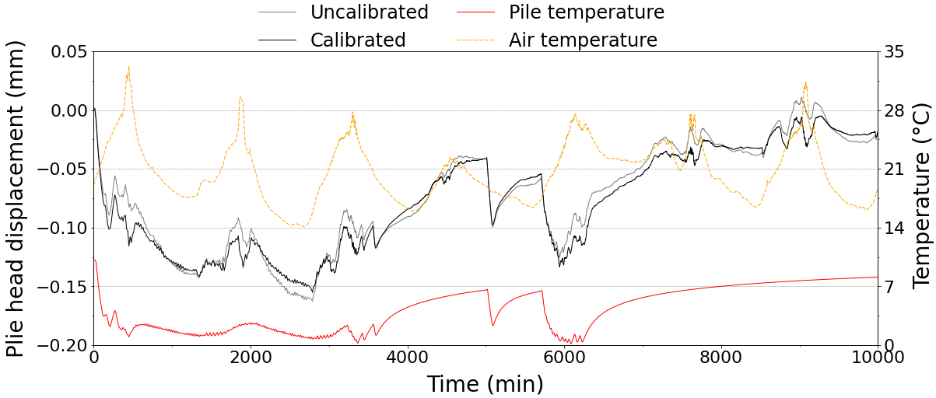
Pile head displacement – fixed loads
Zero applied load: elastic
Impacted by surface and ground temps

Slide 20
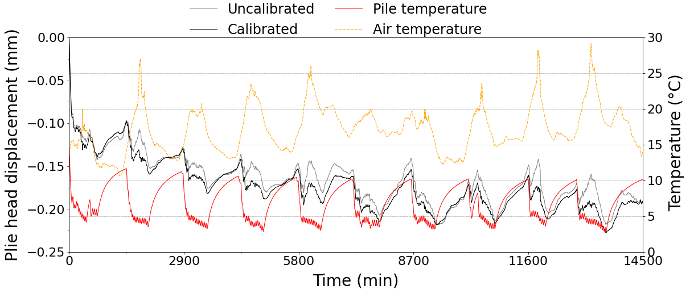
Pile head displacement – fixed loads
40% maximum load: thermal creep, 5 cycles, then elastic

Slide 21
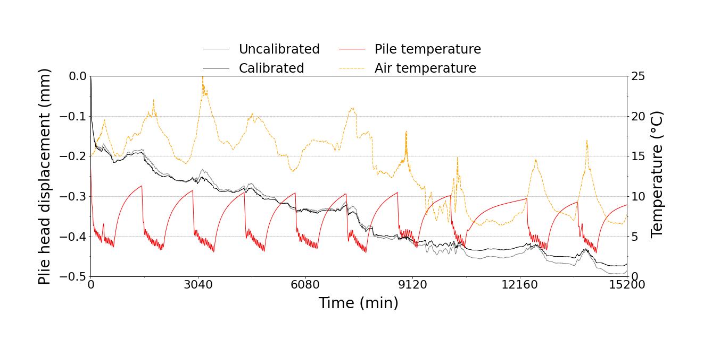
Pile head displacement – fixed loads
60% maximum load: thermal creep, continuous

Slide 22
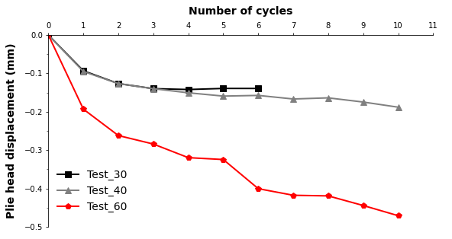
Thermal pile test: thermal creep

Slide 23
Implications for thermal pile design
Long term thermal loads: soil and pile expand/contract: moderate structure displacement.
Displacements are more critical than shear strength in most normal situations.
Reasonable safety factors restrict thermal creep, and soil compaction (CNS)

Slide 24
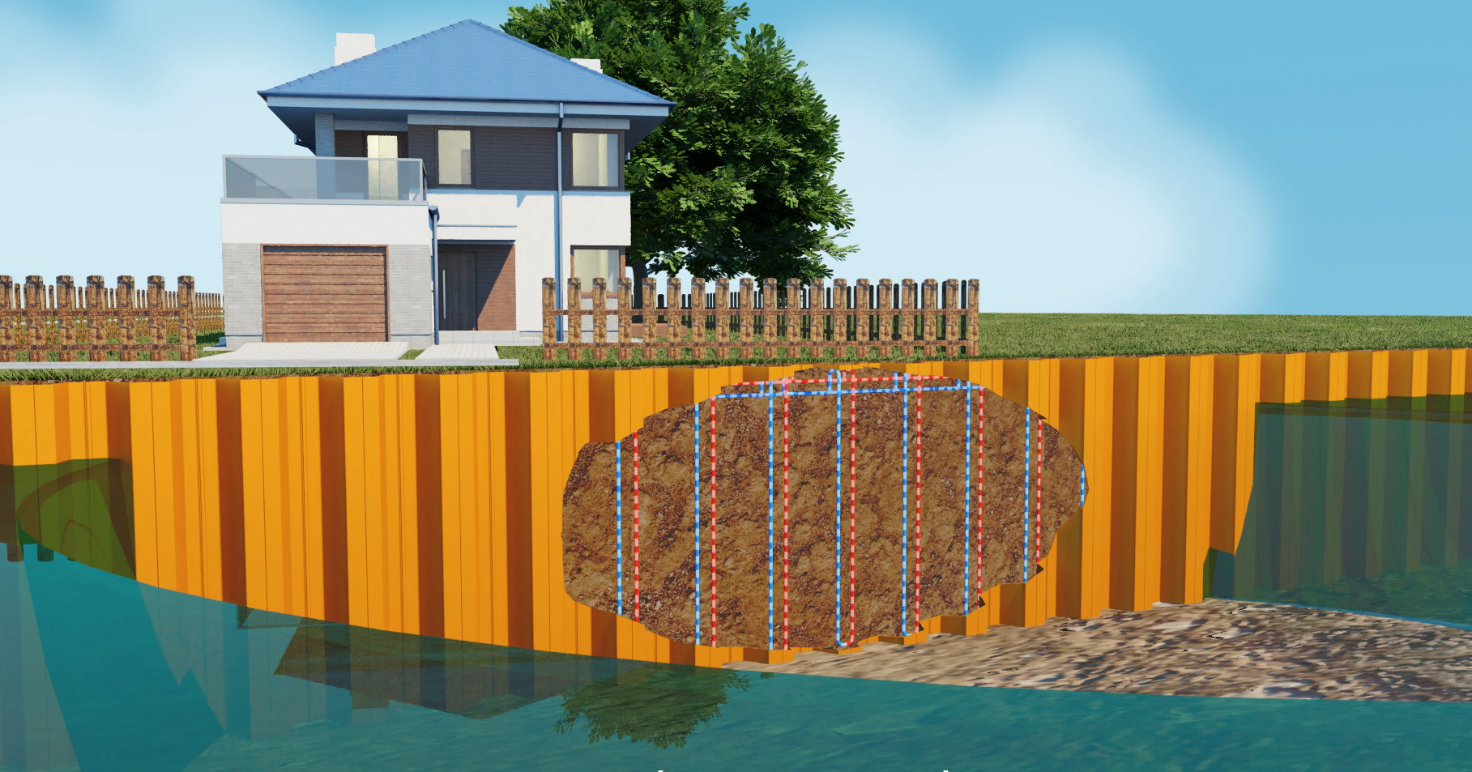
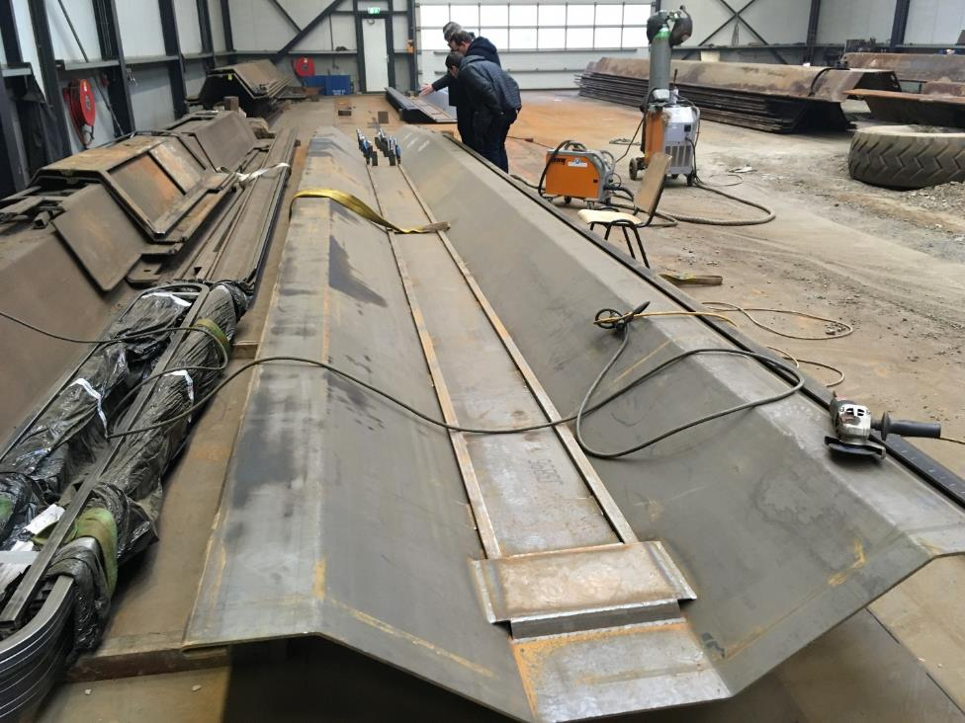




Energy quay wall

Slide 25
Energy quay wall
Don’t rely on confining stress, or shear strength
Energy can come from ground/water:
  Where is the exergy best?

Slide 26
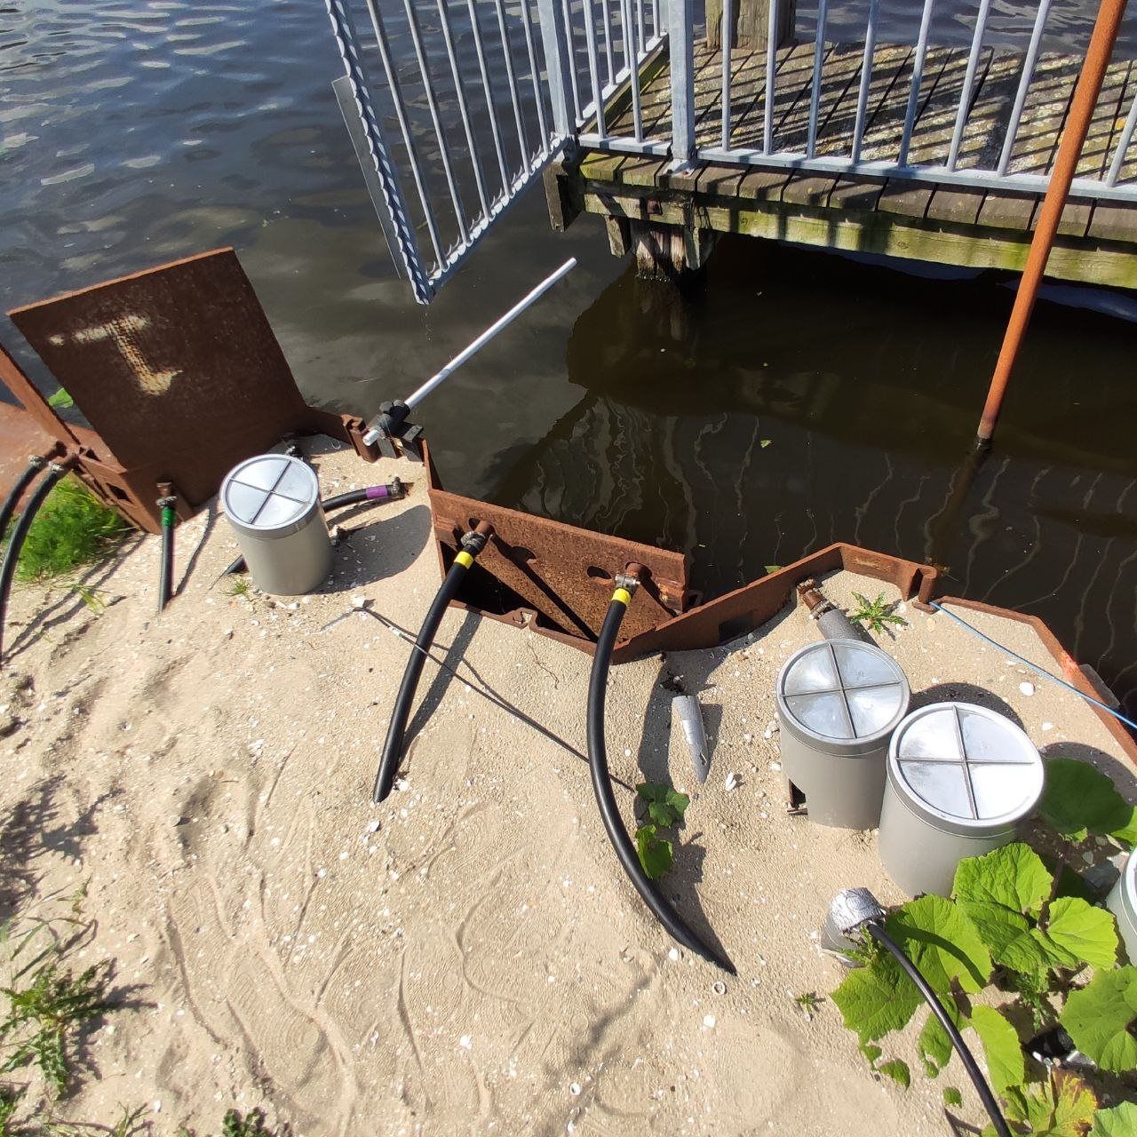
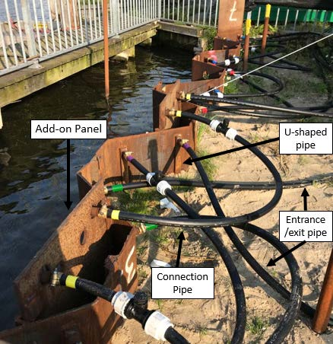
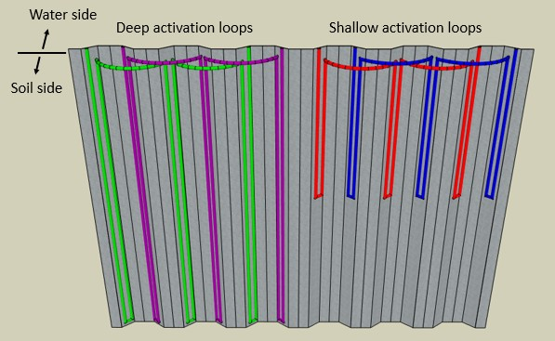
Energy quay wall – field test
1. Deep loops 2. Shallow loops 3.Add-on panels

Slide 27
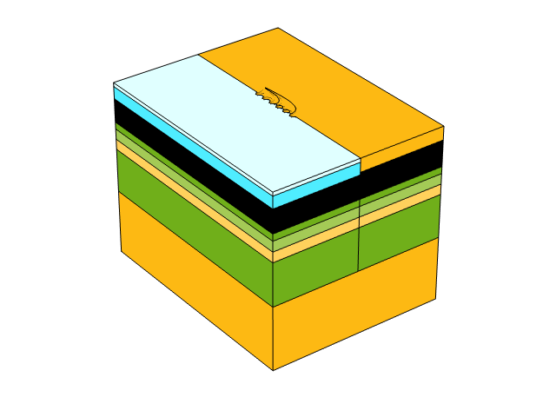
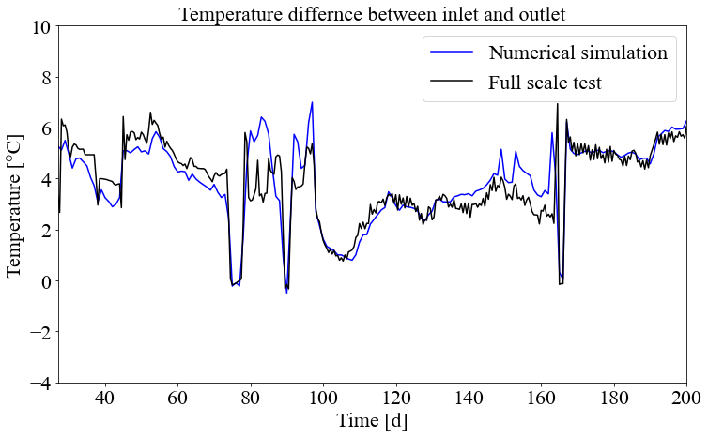
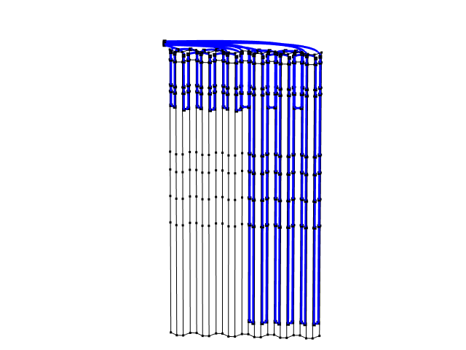
Energy quay wall – field test
Model and field data agree. Field test has valuable data.
Thermo-mechanical changes very small – adding sand backfill more significant.

Slide 28
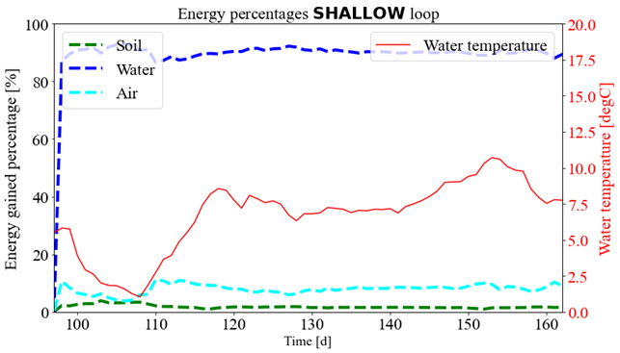
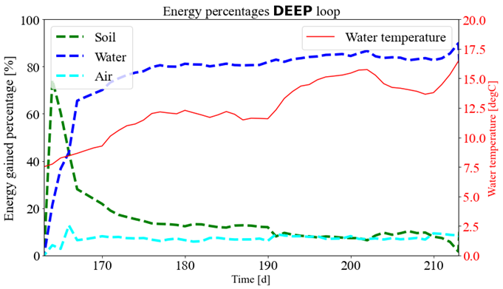
Energy quay wall – field test
Water can provide most energy: unless for short period and cold
Air – water – soil react in this order

Slide 29
Summary
Useful energy is all around…we are in a position to make it useable (and cost-effective).
There are additional geotechnical loads, but in most reasonable cases do not change the structural design.

Slide 30

Phil Vardon
Professor
Geo-Engineering Section TU Delft
T +31 (0)15 27 81456 | E P.J.Vardon@tudelft.nl | W http://www.citg.tudelft.nl/pj-vardon/
Acknowledgements
Colleagues: Ali Golchin, Yimu Gou, Ivo Pantev, Mouadh Rafai, Marco Gerola, Jacco Haasnoot, Vincent Leclerq, Jorrit de Vries, Francesco Cecinato, Ed Revoort
Funders: NWO, RVO

