Slide 1
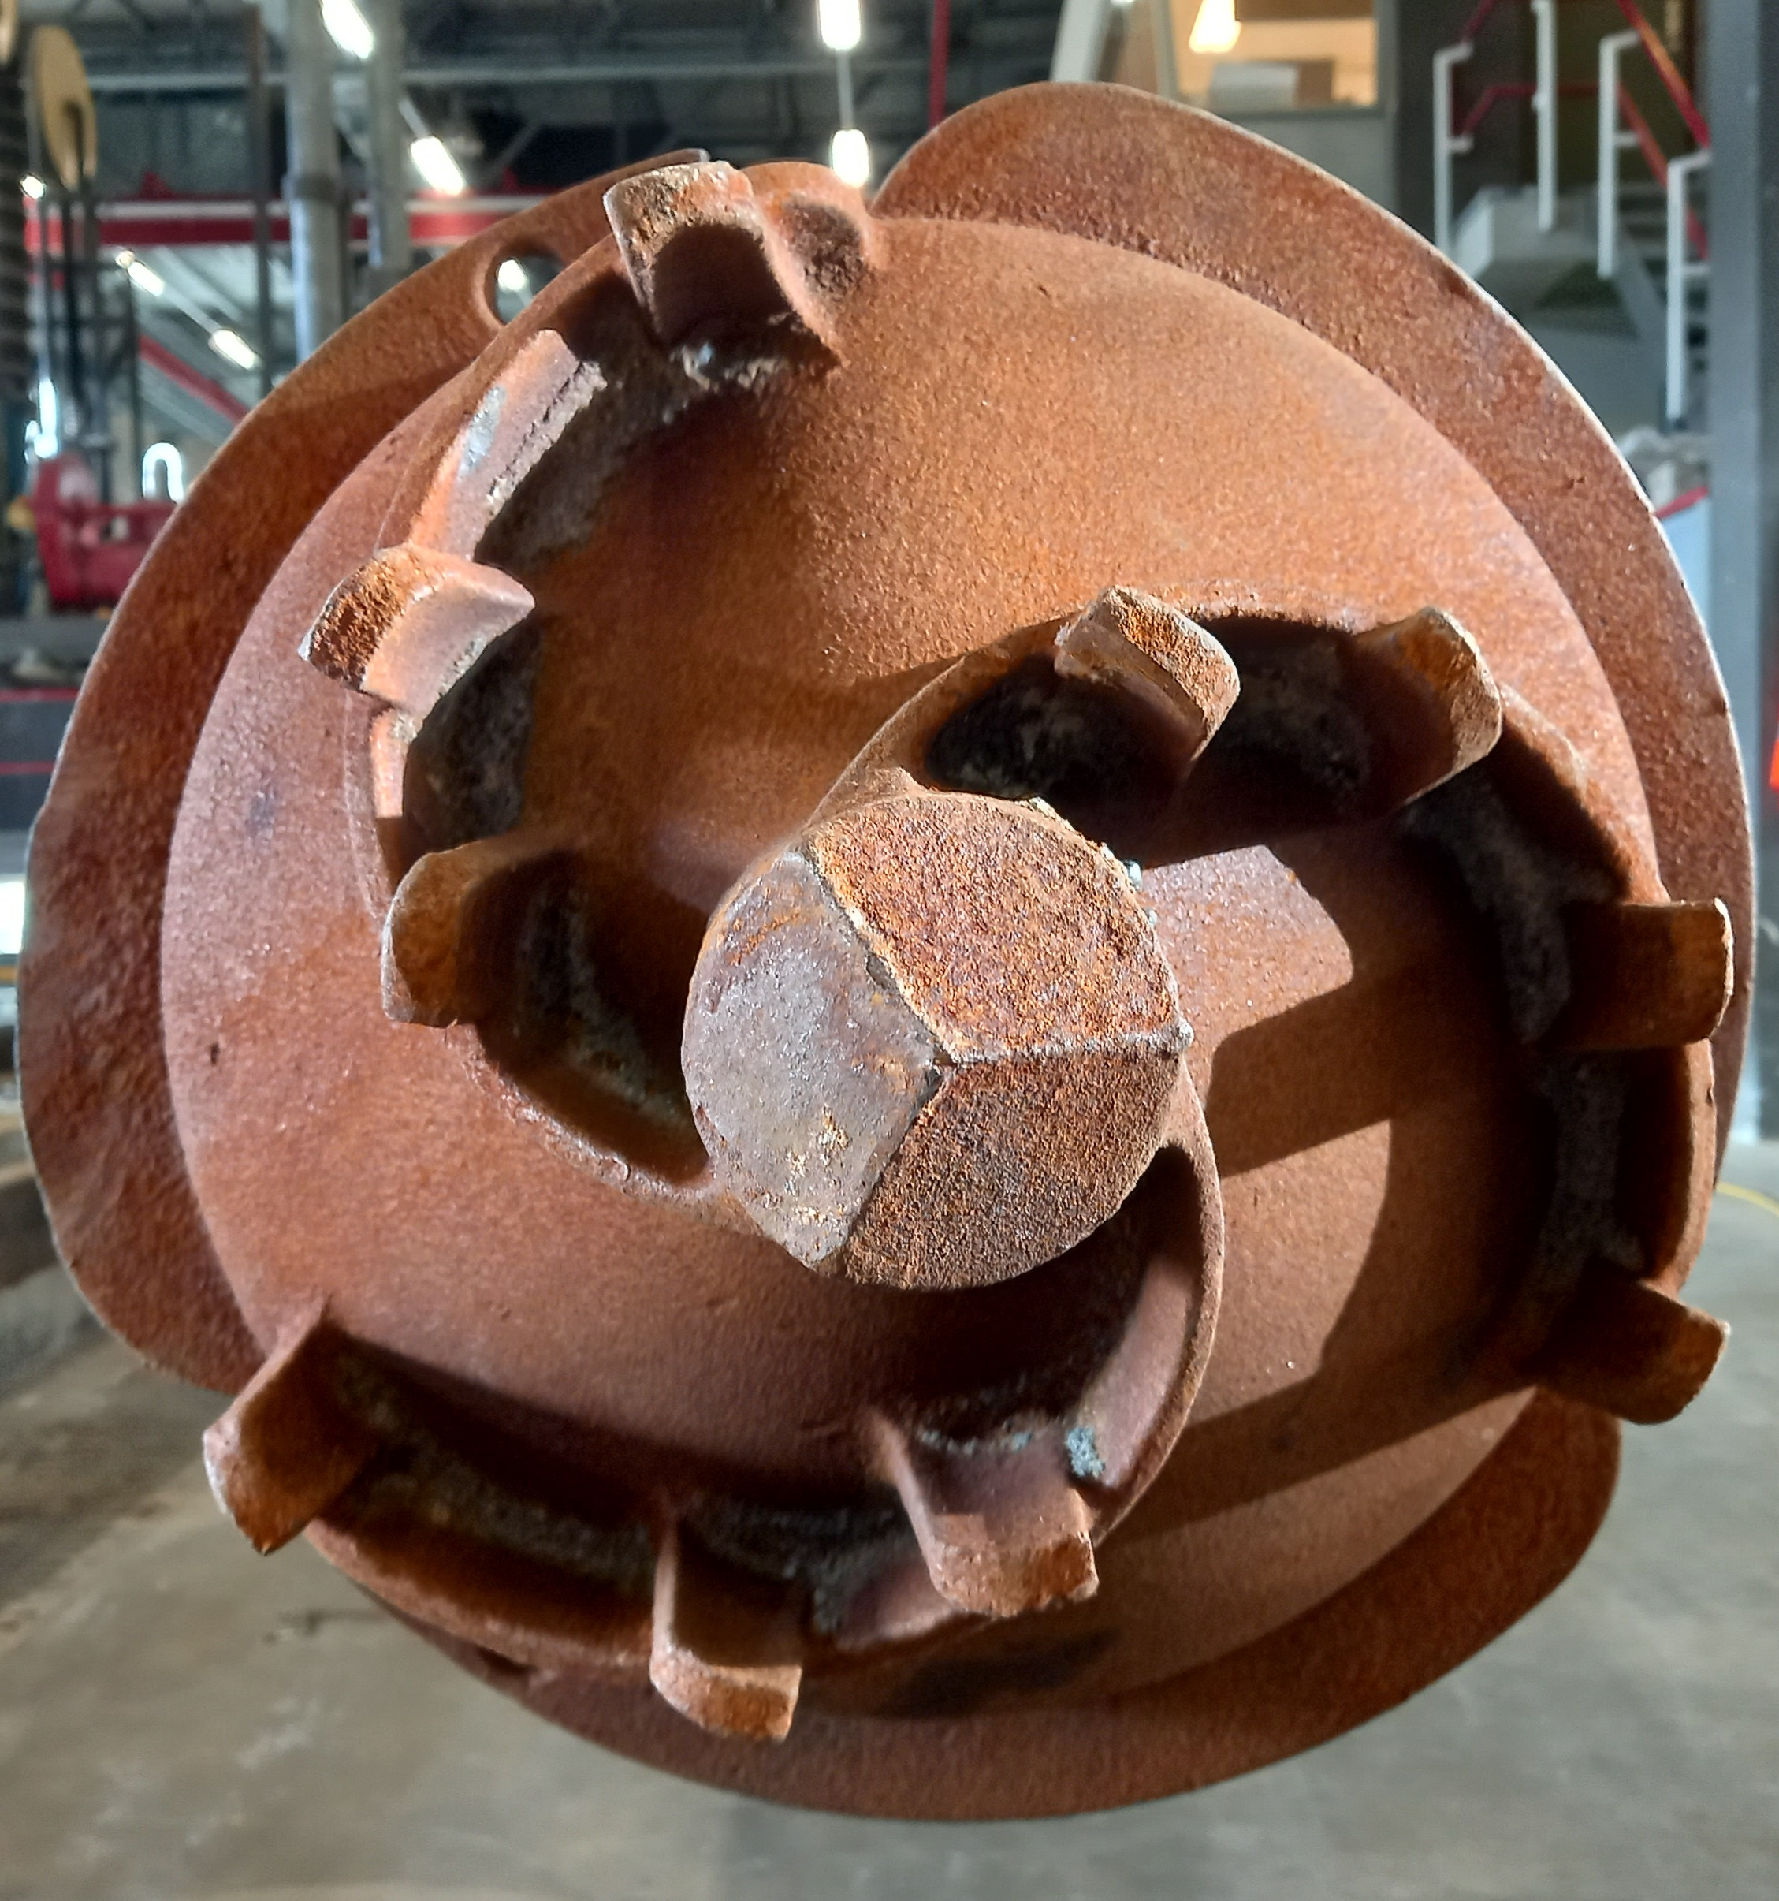
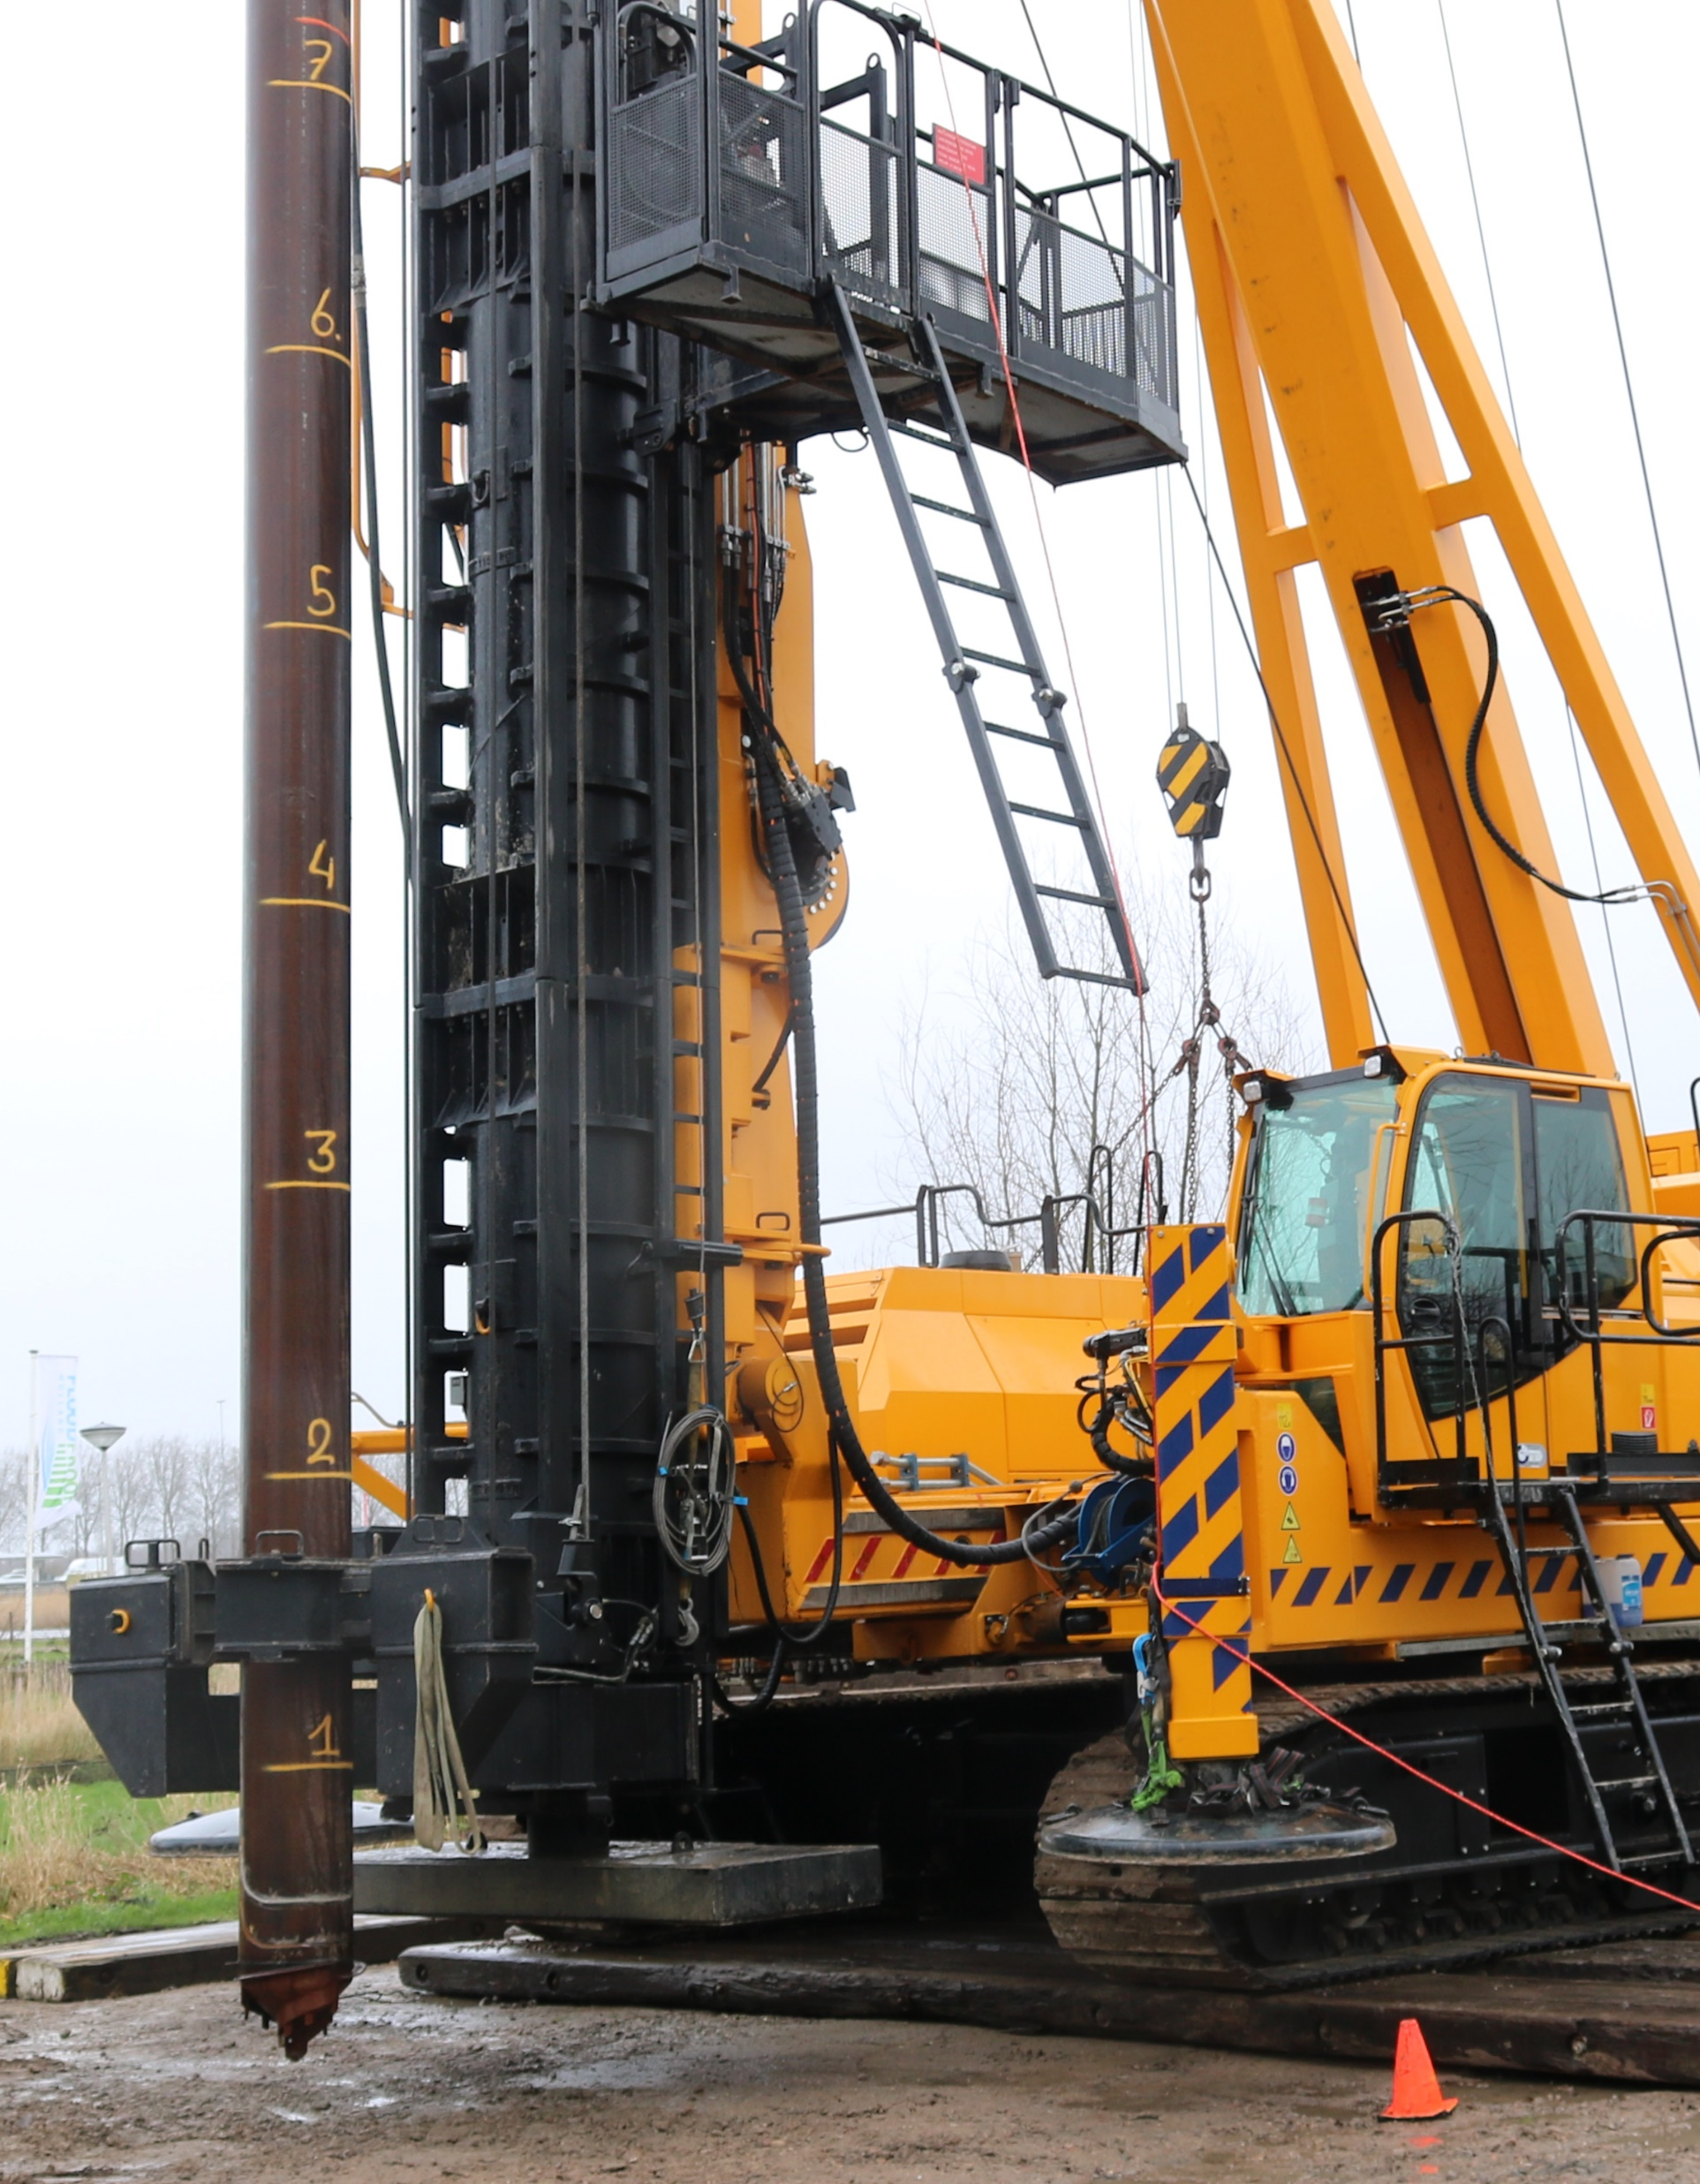
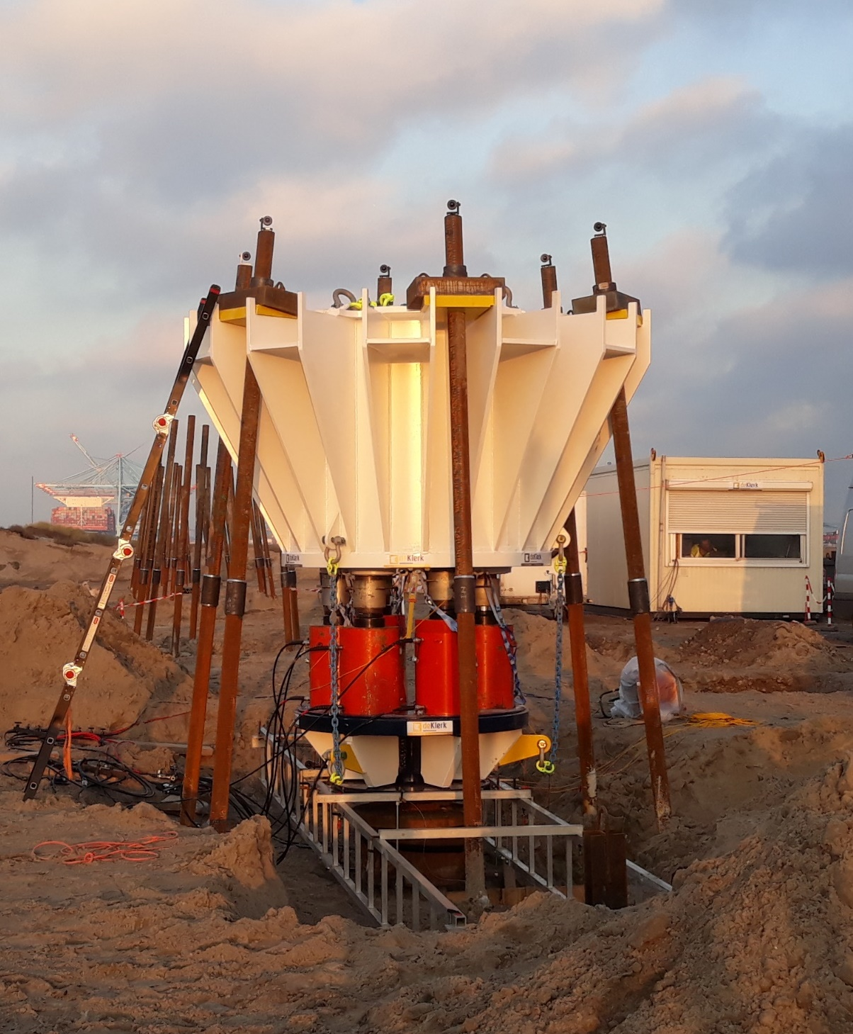
Punt in het zand, kop uit het zand
Axiale draagvermogen van schroefverdringende palen
Kevin Duffy
Post-doctoral Researcher | Faculty of Civil Engineering & Geosciences | TU Delft

Slide 2
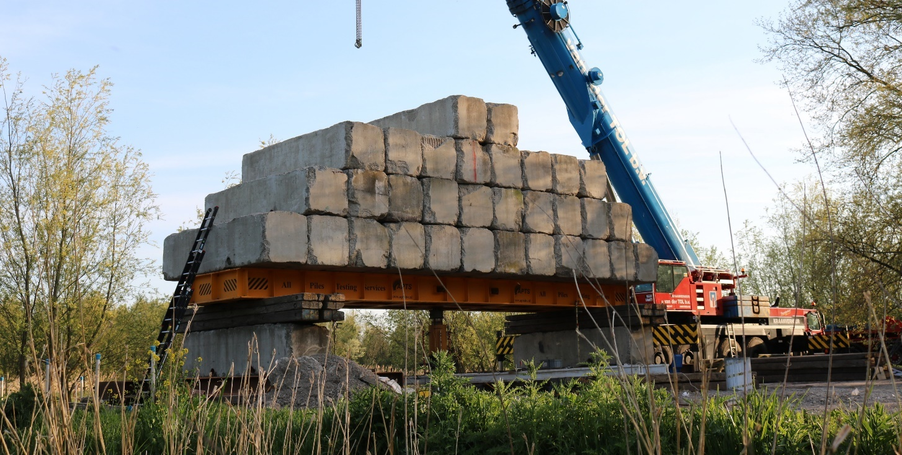
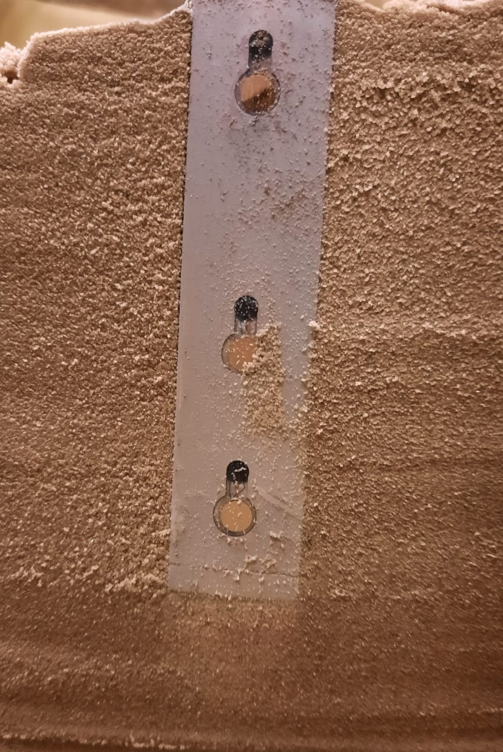
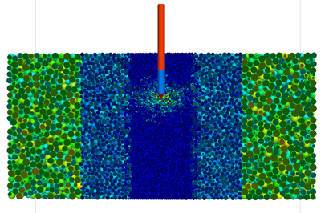
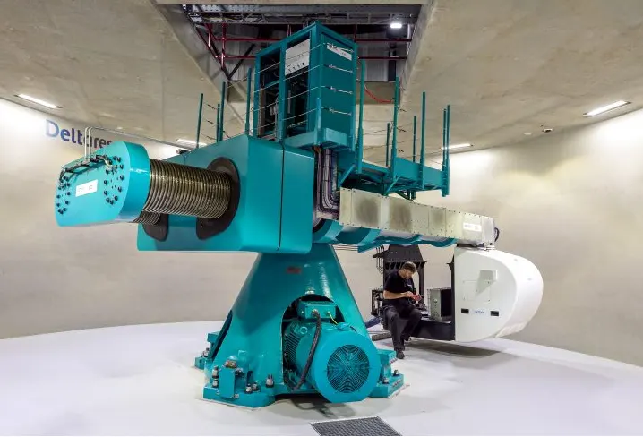
How can we improve axial pile design in NEN 9997-1?
InPAD: Improved Axial Capacity of Piles in Sand (2019-2023)
3 PhDs:
Dirk de Lange Deltares + TU Delft
Fei Chai UNSW (Australia)
Kevin Duffy TU Delft
Stuurgroep:
Ken Gavin
Mandy Korff
Adriaan van Seters
Rodriaan Spruit
Frits van Tol

Slide 3
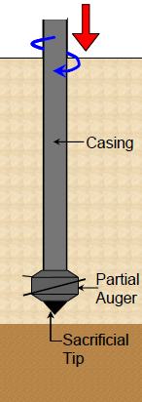
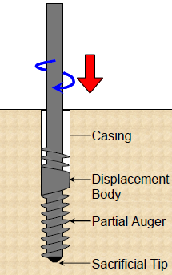
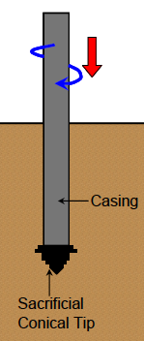
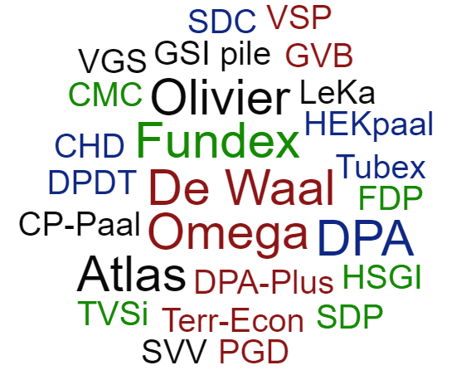
Screw displacement piles Grondverdringende schroefpalen
(Basu & Prezzi, 2009)
with displacement body
with smooth shaft
with helical shaft

Slide 4
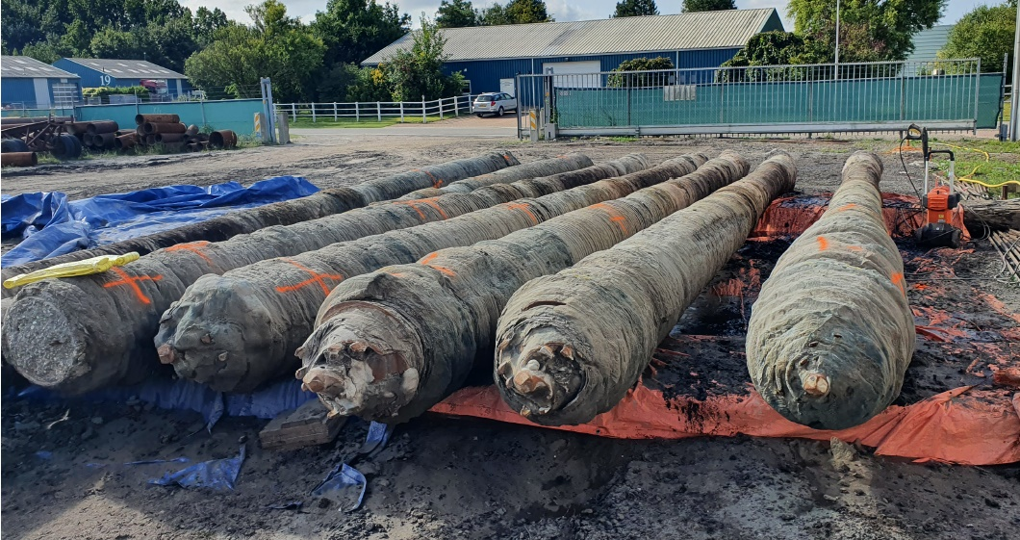
Research into screw displacement piles
BAP Screw Pile Symposiums
Also research from…
USA (Basu & Prezzi, 2010, Figueroa 2022)
Europe (Krasinski, 2021)
Australia (Slatter, 2000; Larisch, 2014)
NEN 9997-1 2017: 30% reduction in α_{p} across all pile types
0.009
$$q_{s}=α_{s}q_{c}$$
$$q_{b}=α_{p}q_{c,avg}$$
0.63
NVAF tests at Lemmer (Aguilar et al., 2021)

Slide 5
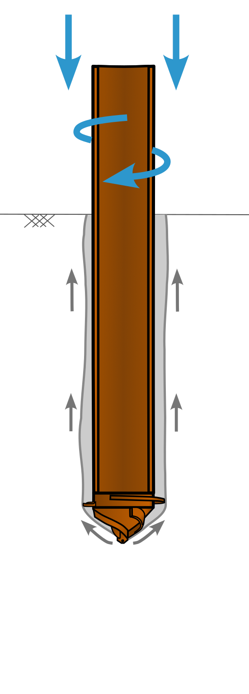
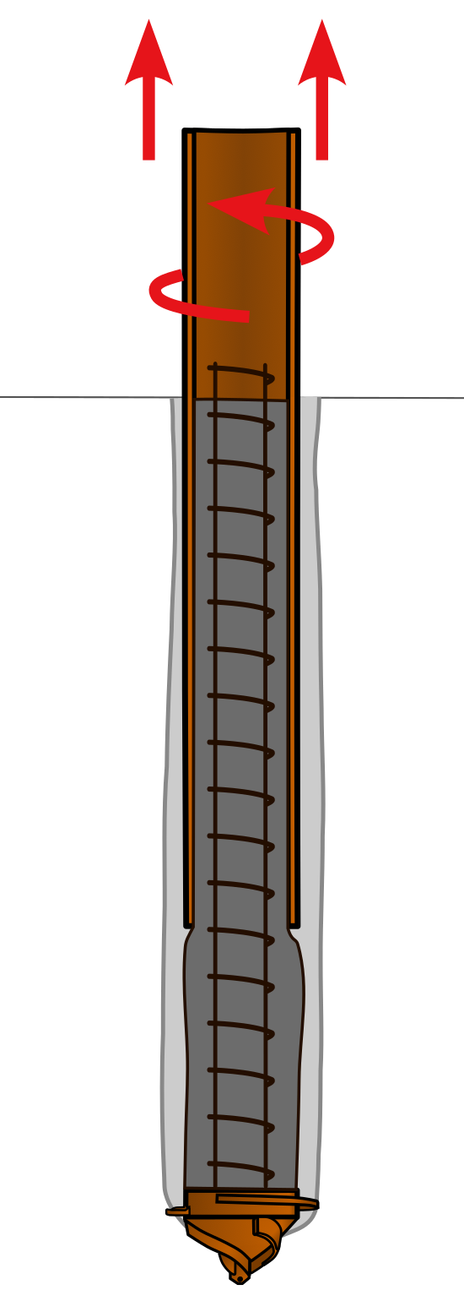
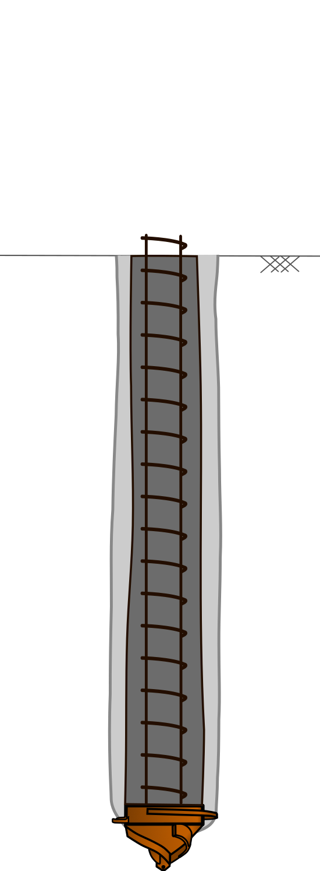
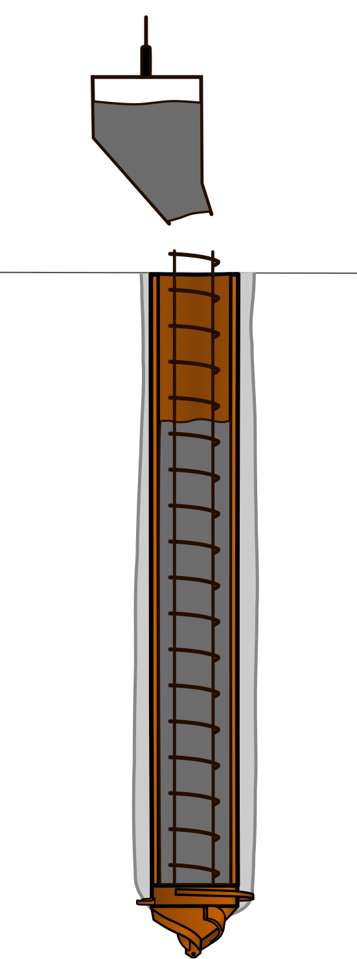
Screw injection pile
Grout
Grout

Slide 6
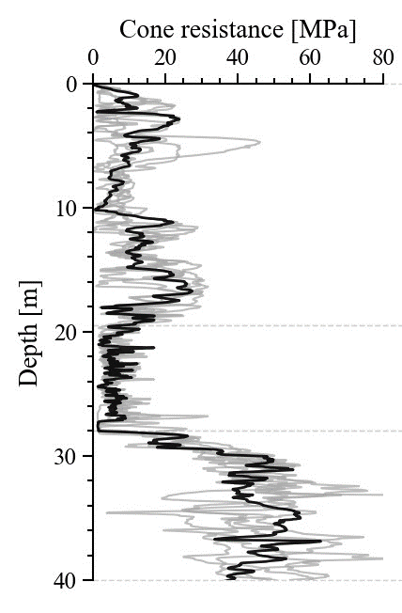
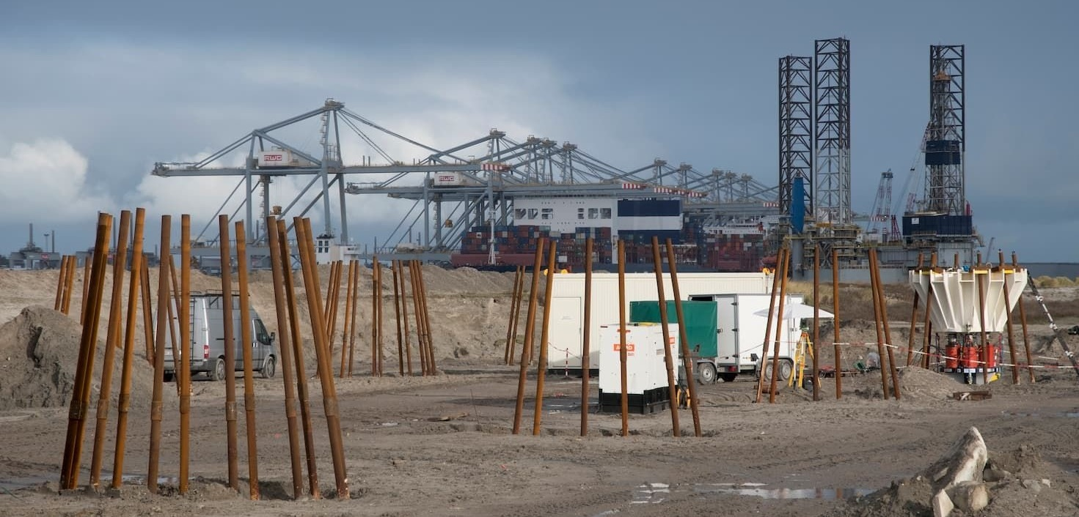
Tests at Amaliahaven, Maasvlakte II (2019–2020)
3 × Driven precast ⧄ 400 mm 32 m
4 × Driven cast-in-situ ⌀ 480 mm 32 m
4 × Screw injection ⌀ 850 mm 37m

Slide 7
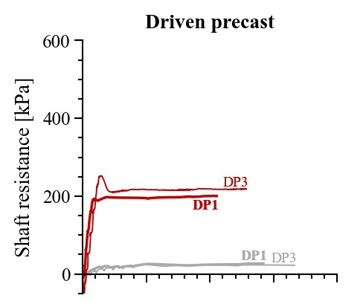
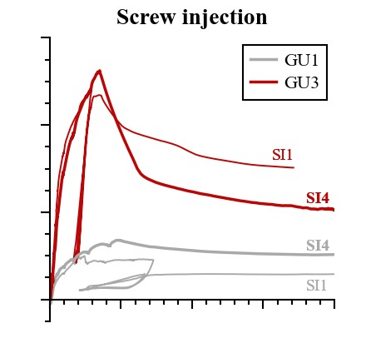
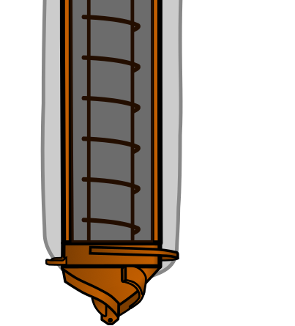

Slide 8
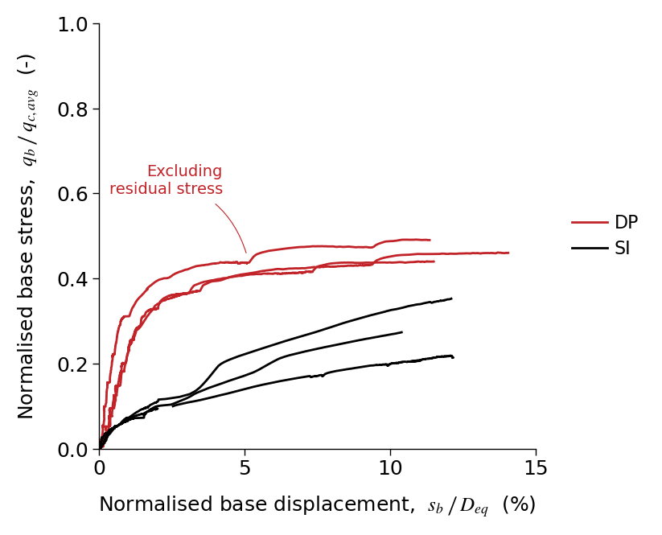
Normalised base stress, α_{p,filter} (-)
Driven closed-ended
Screw injection

Slide 9
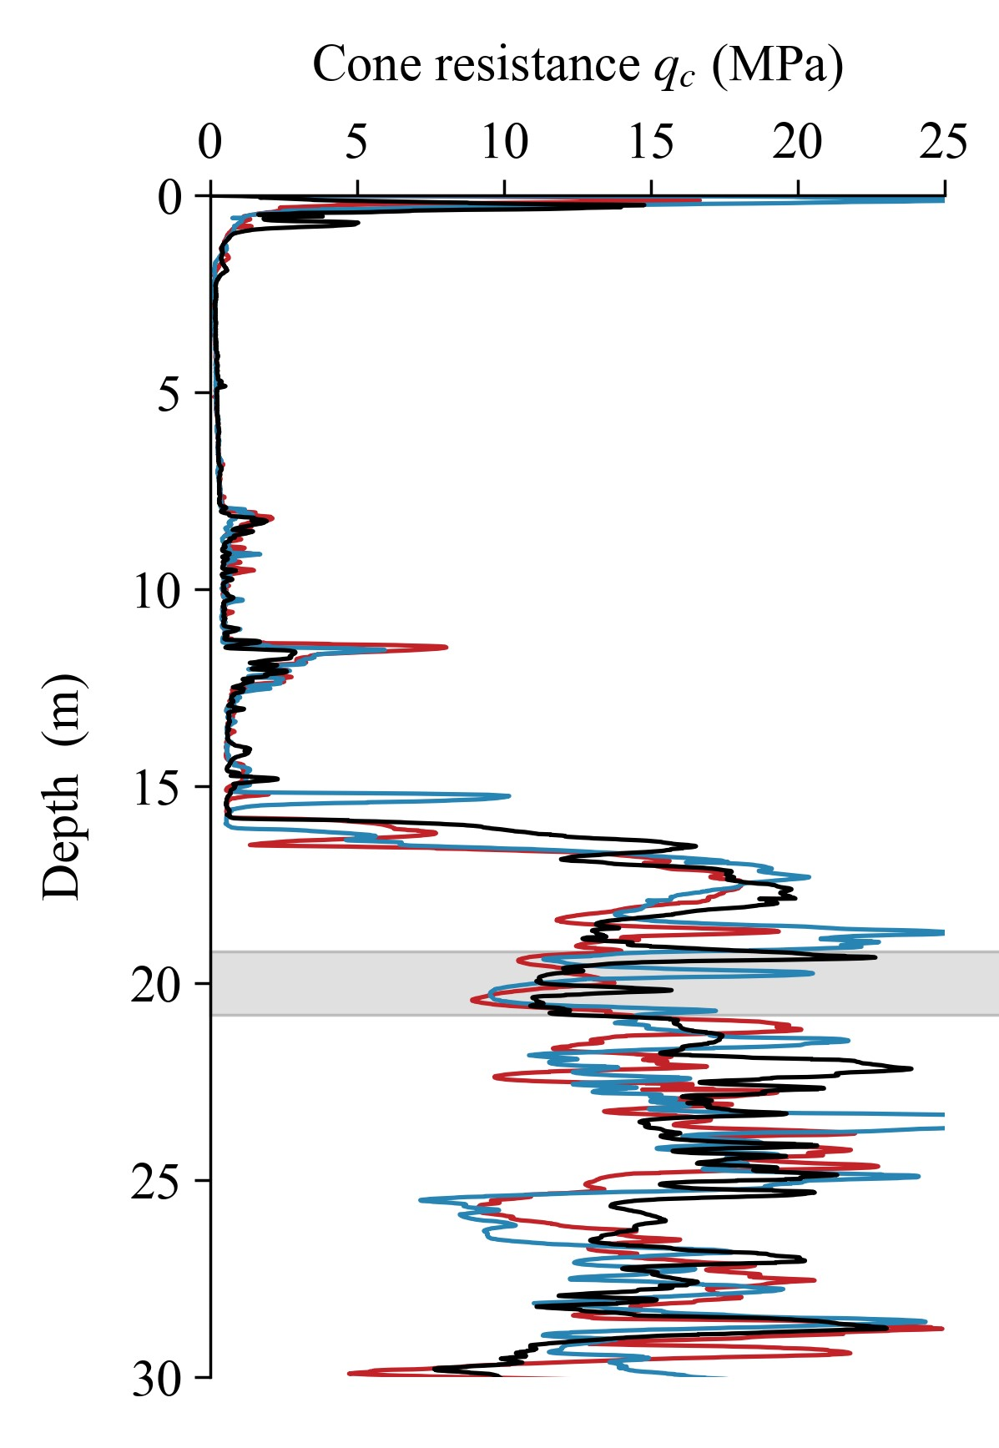
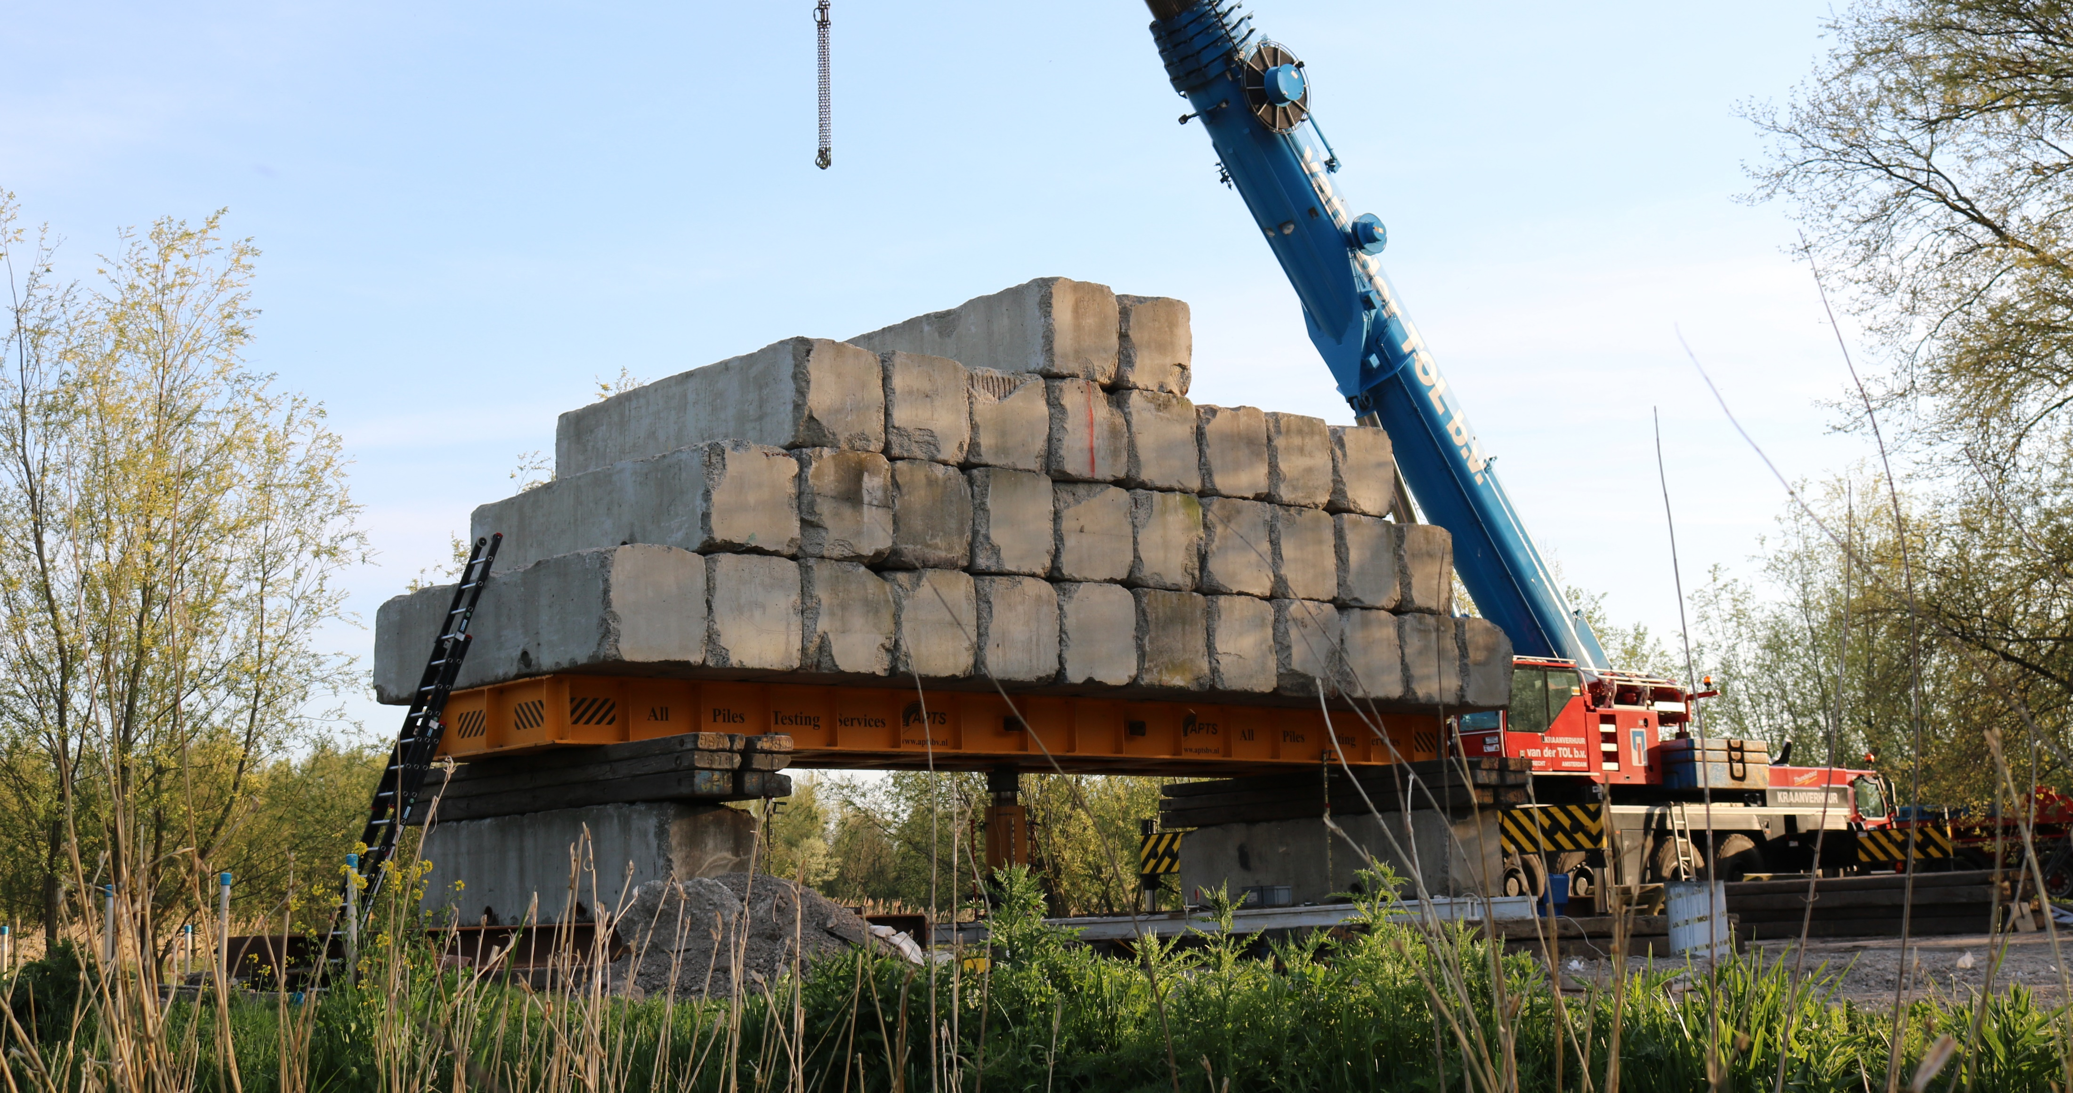
Tests at Delft (2022)
3 × SI piles without casing ⌀ 380/470 mm 20 m
3 × SI piles with casing ⌀ 380/470 mm 20 m
Pile tip depths

Slide 10
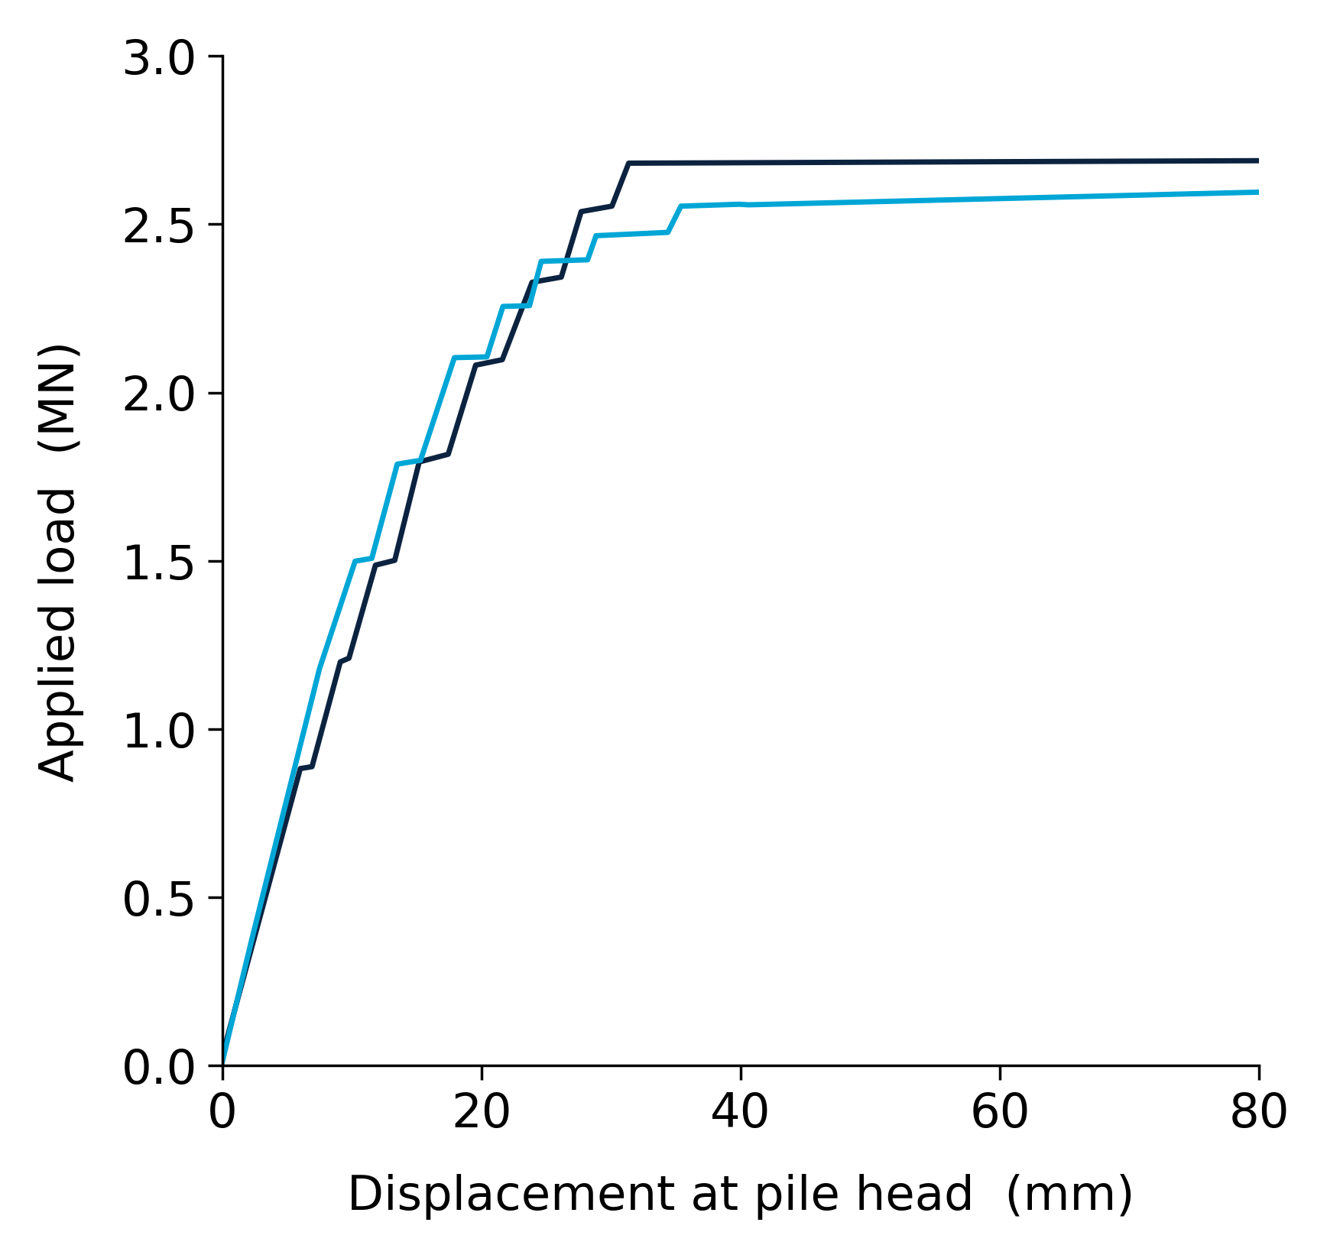
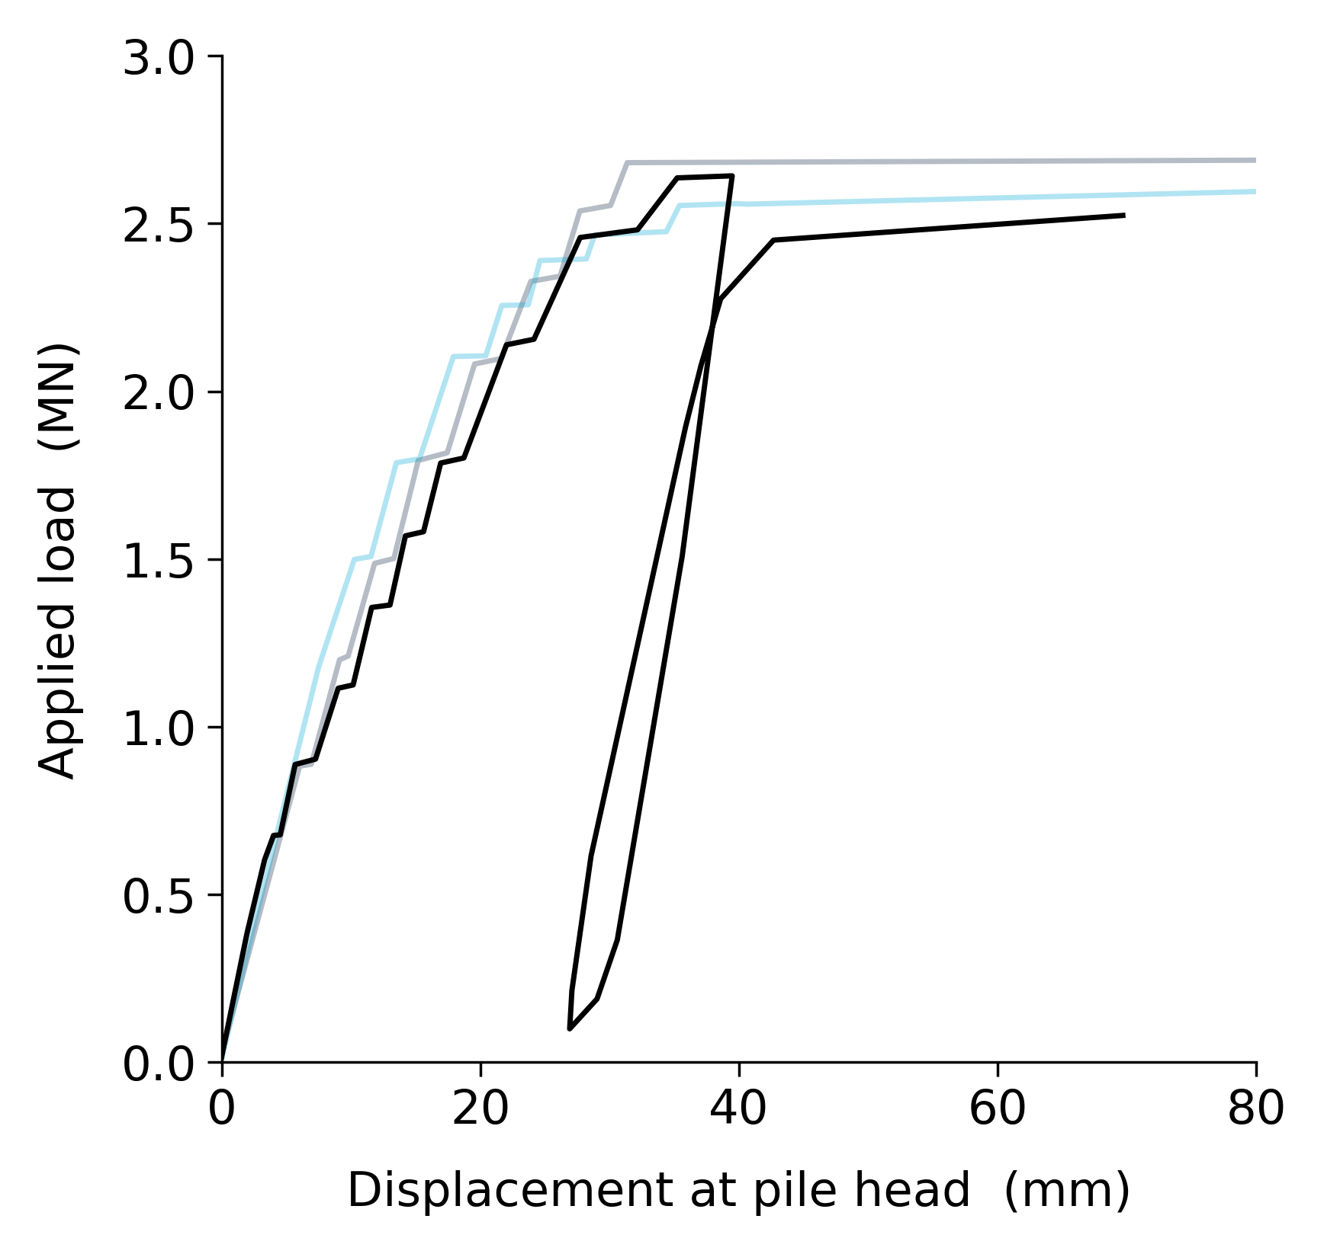
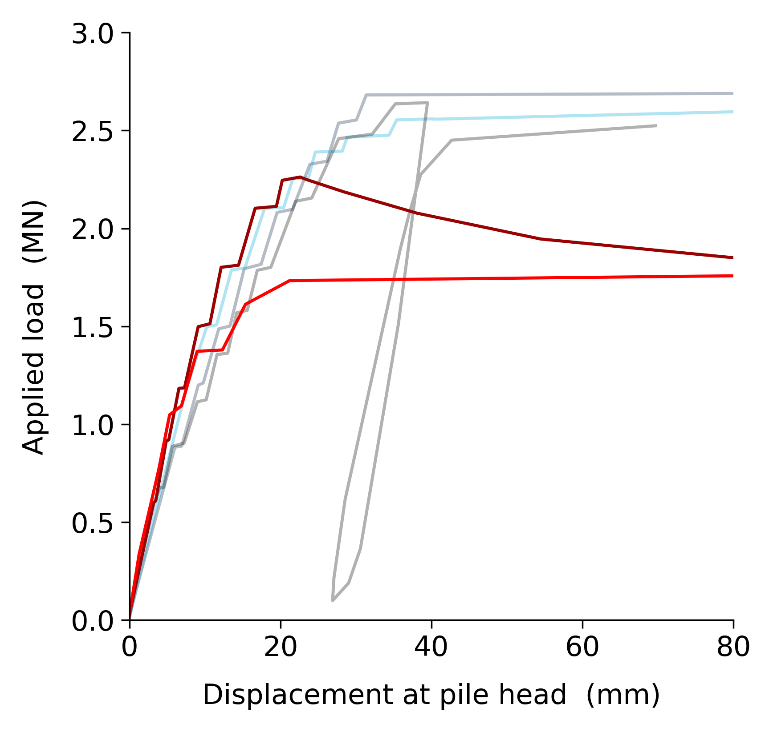
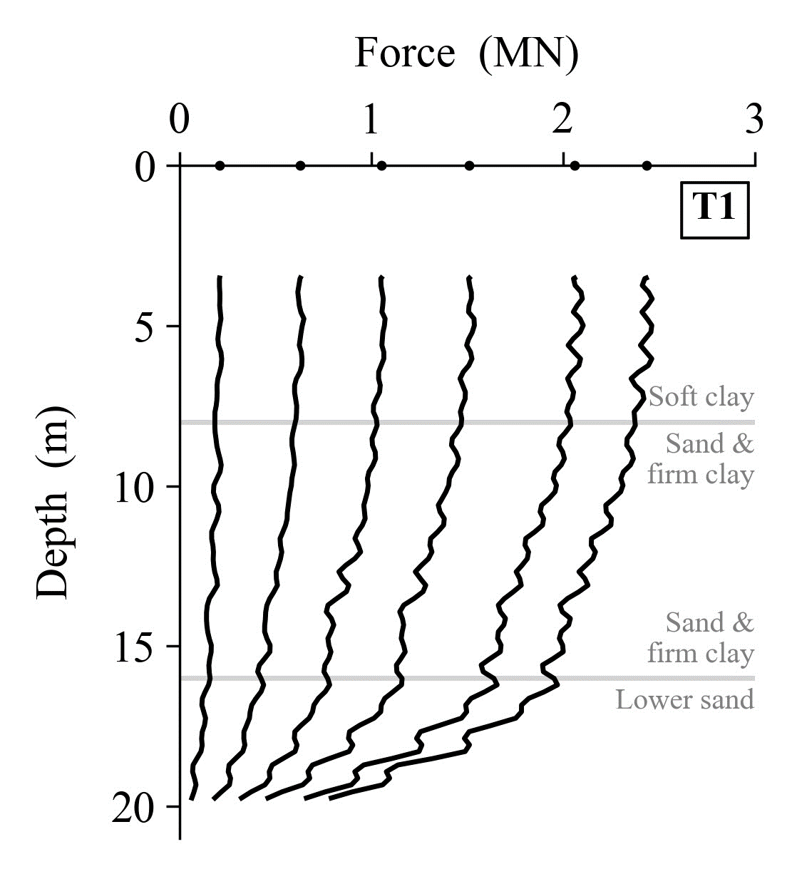
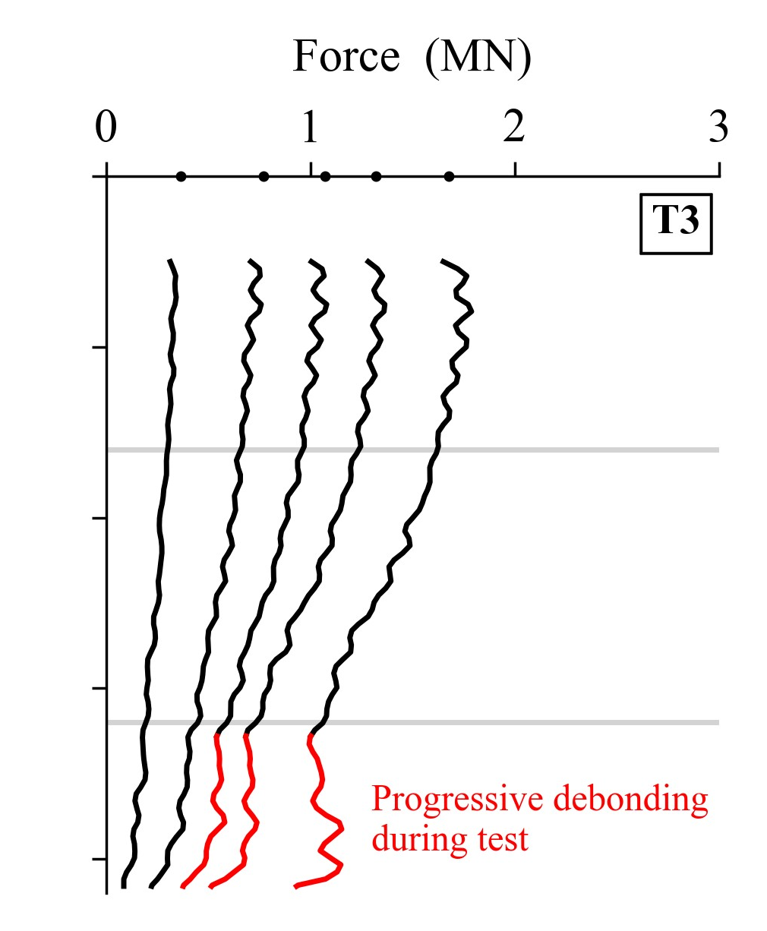

Slide 11
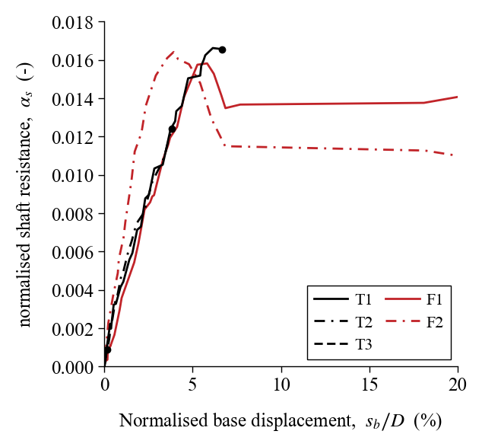

Slide 12
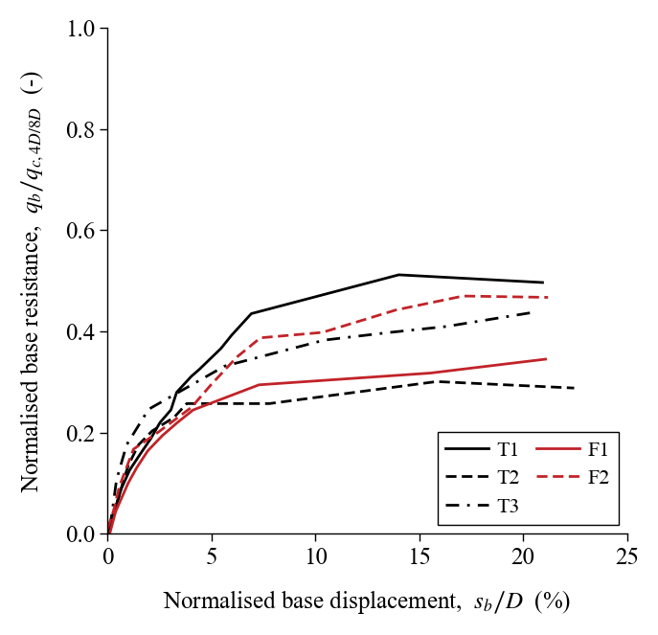

Slide 13
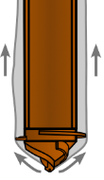
TU Delft Screw Displacement Pile Database
Screw displacement axial pile tests performed worldwide
Primarily USA, NL, Belgium
179 tests in total; 43% instrumented
All screw displacement pile types e.g. Atlas, DPA, Olivier, Omega, SI
23 used for assessing base resistance

Slide 14
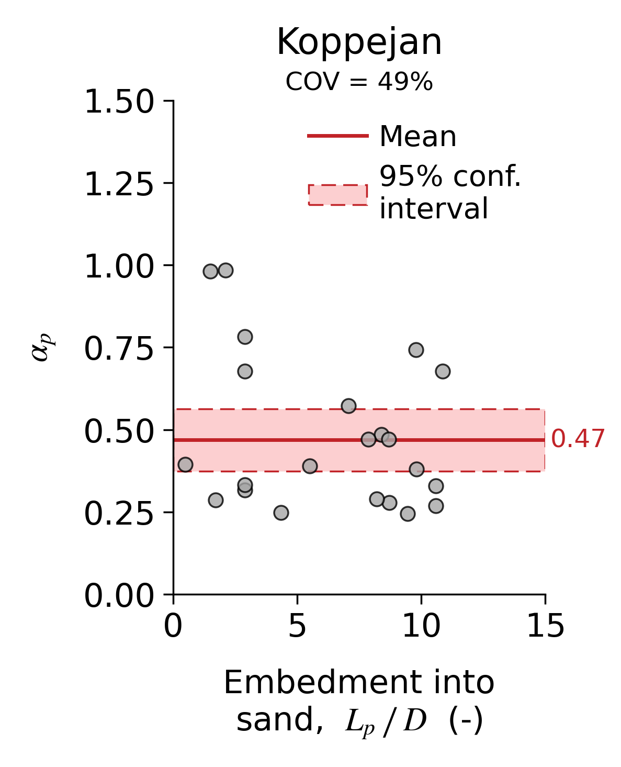
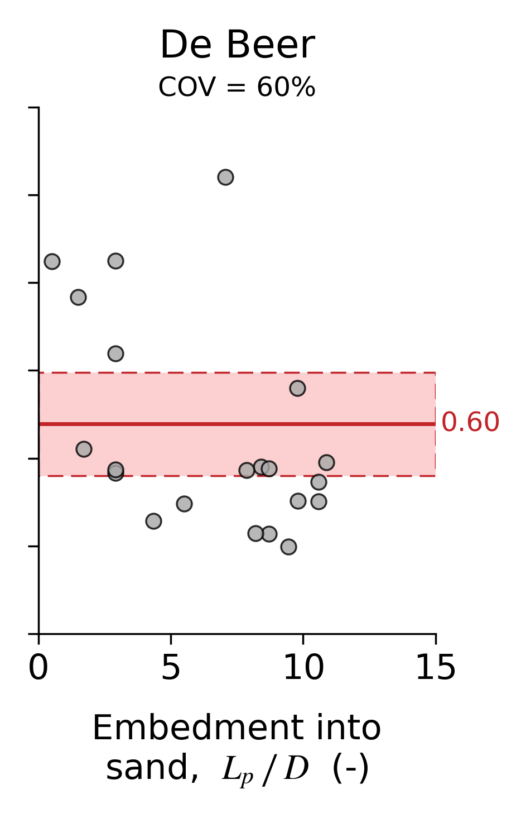
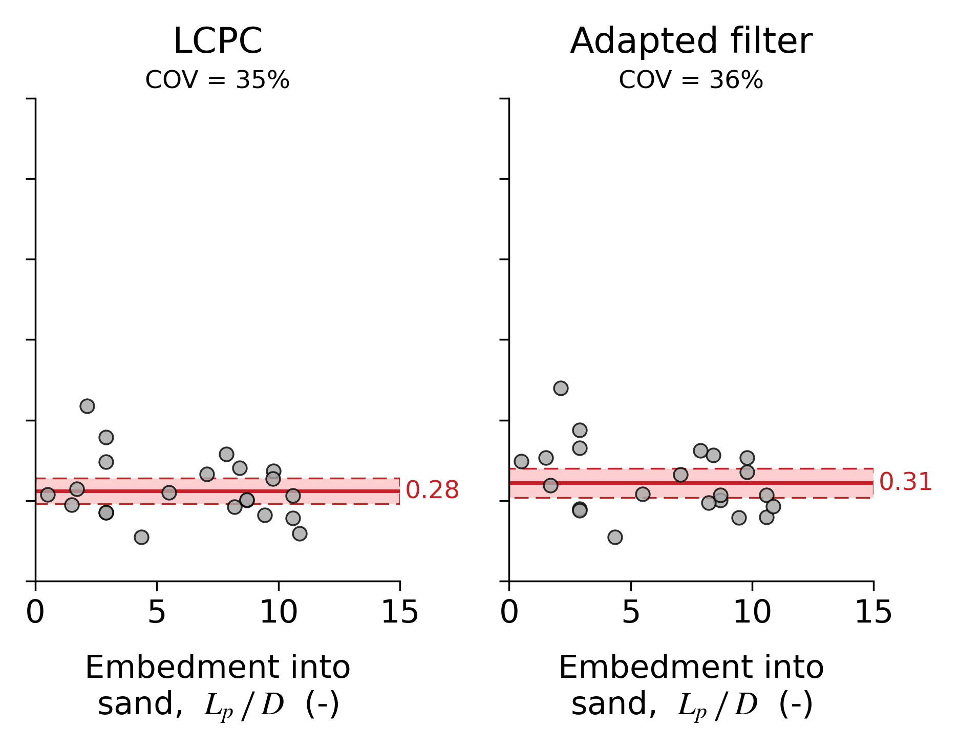

Slide 15
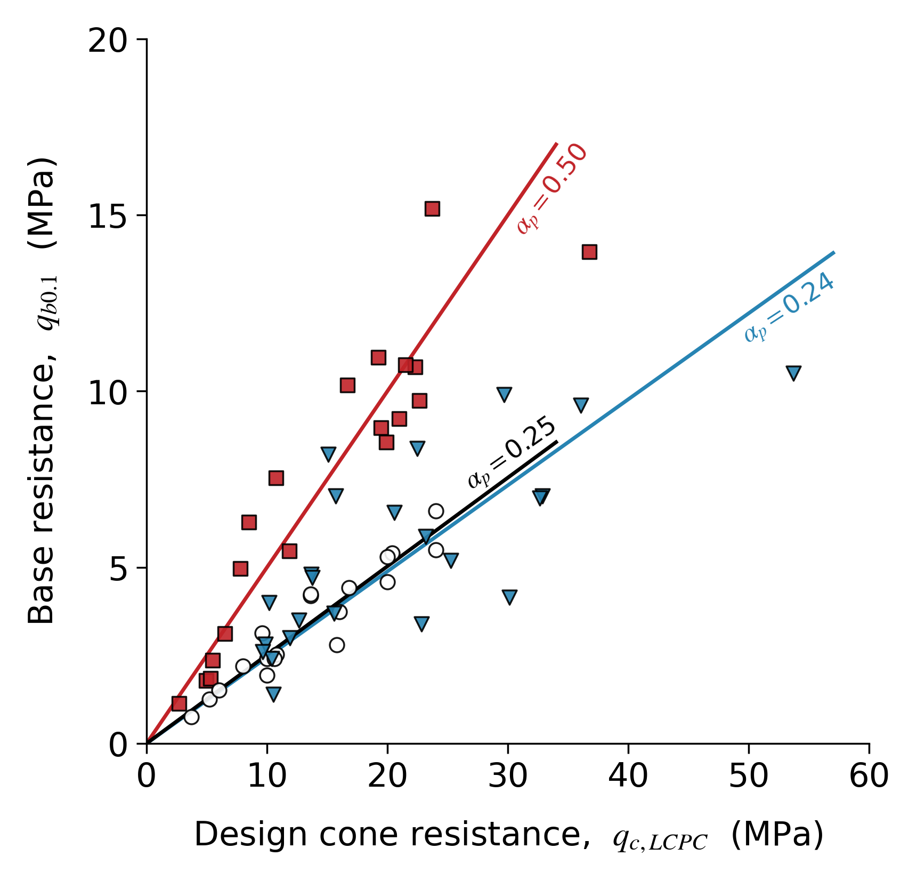
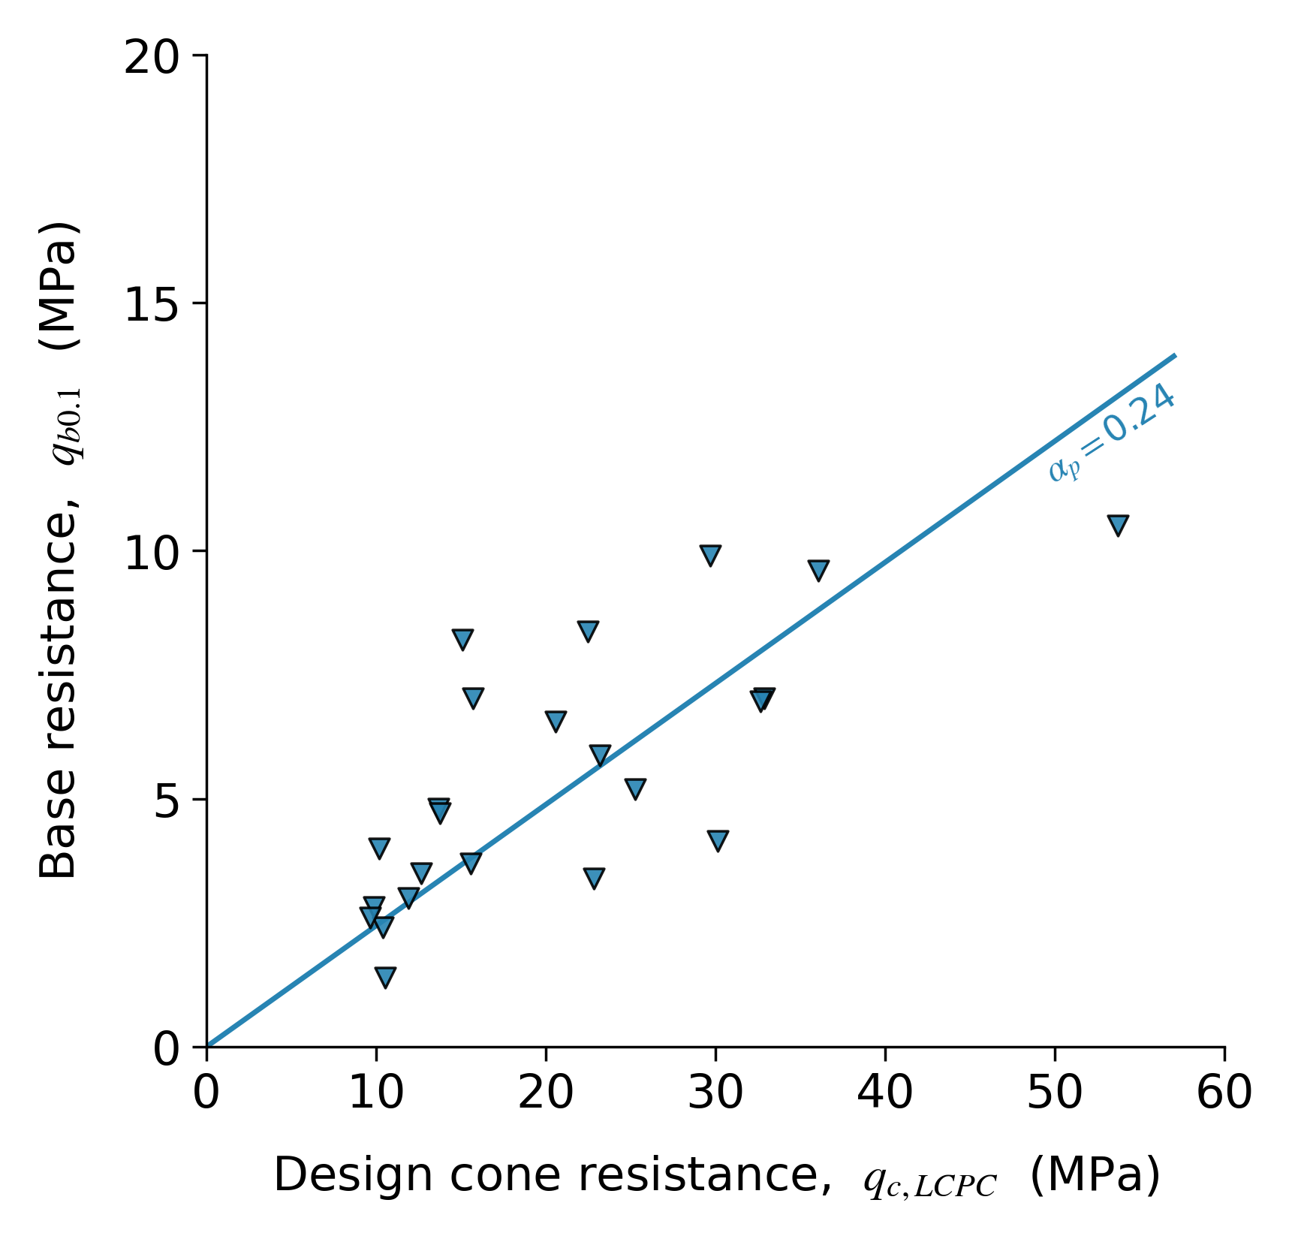
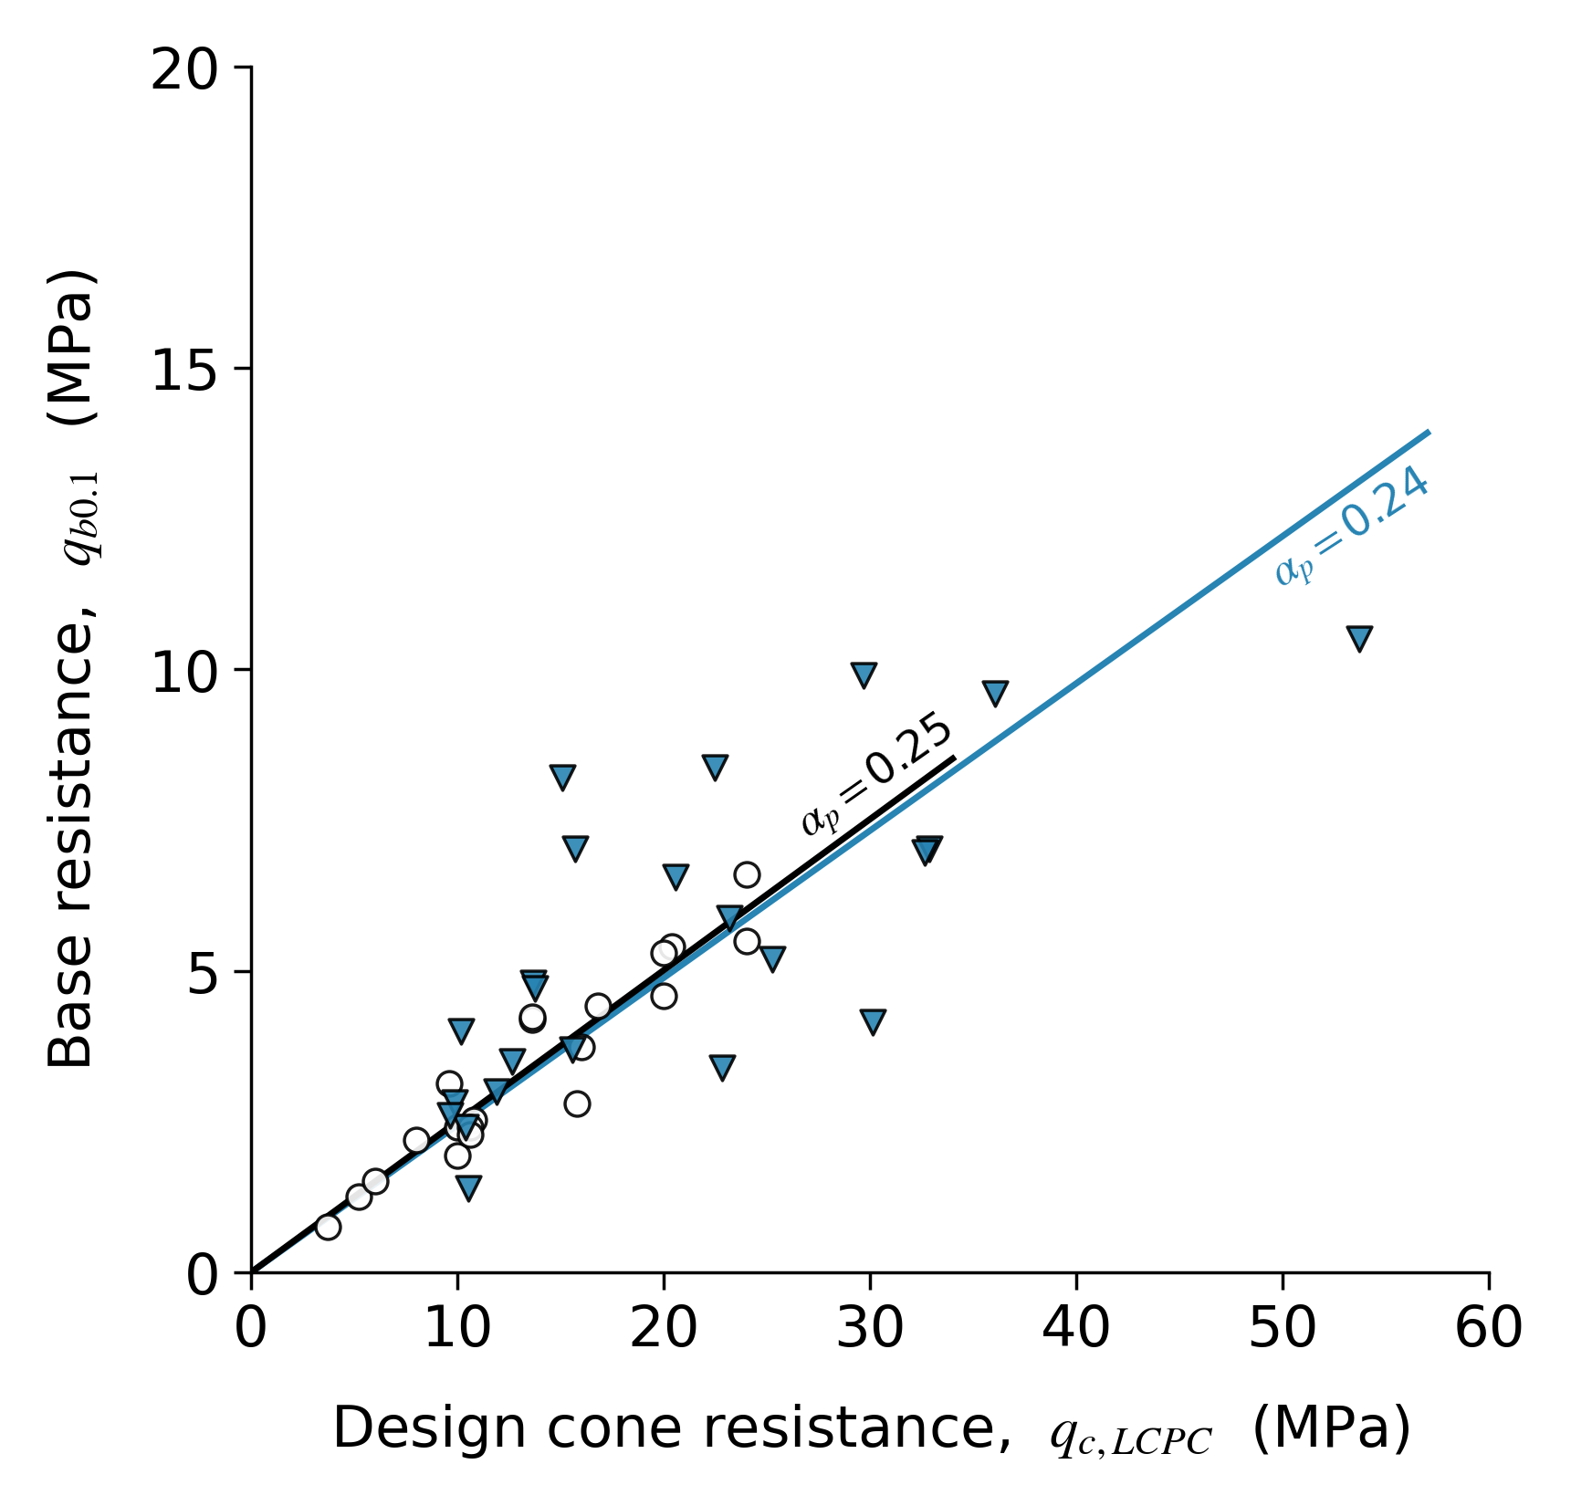
Screw displacement
TU Delft database
Bored & CFA
Gavin et al., 2013
Driven closed-ended
Bittar et al., 2020

Slide 16
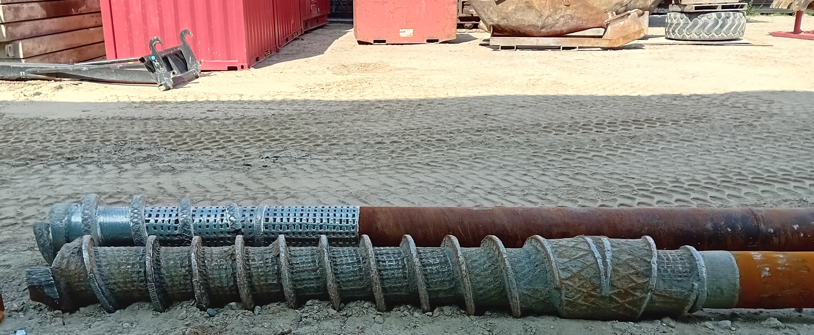
Conclusion
Base response of screw displacement piles tends to behave more like a bored pile than a driven precast pile (i.e. lower α_{p})
Averaging method has a significant effect on how α_{p} is interpreted
Higher α_{s} factors than initially expected could be mobilised, although structural capacity plays an important role
Can we accurately quantify the beneficial effect of screw displacement pile installation on α_{s}?
Urban quay wall renewal in Amsterdam
Static load tests on DPA and DPA-plus piles
Kevin Duffy | k.duffy@tudelft.nl

